Slide 1

The Children’s code
Age group 9-11

Slide 2
Introduction
In September 2021, the ICO launched new rules governing how online services collect and use children and young people’s personal data.
These rules are known as the Children’s code,
and are designed to protect children and young people’s personal data.
This resource is designed to follow on from the Your Data Matters school resources. The aim is to make your pupils aware of what the Children’s code is, and how it affects them.
There is an accompanying downloadable document,
The Children’s code summary, which outlines some key information about the Children’s code.
Age: Pupils aged 9 to 11
Timings: 40 – 55 minutes
Resources:
Children’s code presentation
Activity 1: Children’s code – Key words
Activity 2: Children’s code - Kept or broken?
Exit cards
Background for teachers: Children’s code summary
Glue and scissors
Teacher FAQs
Children’s code infographic - for sending home to parents
Guidance for teaching:
Take time to set clear ground-rules around listening, respect, and not using personal or sensitive examples.
Create a positive classroom culture where students feel able to ask questions and also have the right to pass if they don’t feel comfortable answering a question.
Ensure you are familiar with your school’s safeguarding policy and procedures, including what do if a student makes a disclosure.
Ensure that any other whole school policies are followed, such as e-safety.
Notes:
This resource has been developed with guidance from the PSHE Association, Department for Education (England), Department for Education and Skills (Wales), Education Scotland, Department of Education (NI).
The Children’s code infographic can be sent home to parents, to encourage pupils to continue the discussion at home.

Slide 3


“This resource about the Children's code is excellent - the information is broken down well and is very child friendly.
The resource will make pupils more aware about the personal data that they share, and highlights the important issues that we all need to be aware of in an ever-changing digital world."
Mrs Siobhan Gillen, School Principal
Steelstown Primary School

Slide 4
Curriculum links
England
DFE RSE and Health Guidance:
Pupils should know:
how information and data is shared and used online.
Ofsted personal development judgement
Schools support pupils to develop in many diverse aspects of life including:
enabling pupils to recognise online and offline risks to their well-being and making them aware of the support available to them
enabling pupils to recognise the dangers of inappropriate use of mobile technology and social media.
Curriculum Links to PSHE programme of Study:
KS2
H37. reasons for following and complying with regulations and restrictions (including age restrictions); how they promote personal safety and wellbeing with reference to social media, television programmes, films, games and online gaming
L11. recognise ways in which the internet and social media can be used both positively and negatively
L13. about some of the different ways information and data is shared and used online, including for commercial purposes
Notes:
Curriculum links for England

Slide 5
Curriculum links
Wales
Welsh Digital Competence Framework - Citizenship
Citizenship: Identity, image, reputation
Year 5
Talk about the impact that the digital content created can have, e.g. think critically about the information shared online
Explain why it is important to discuss their use of technology with an adult
Year 6
Identify benefits and risks of mobile devices broadcasting the location of the user/device, e.g. apps accessing location
Identify the benefits and risks of giving personal information and device access to different software
Scotland
Digital Literacy
Technologies – Cyber resilience
First
I can extend my knowledge of how to use digital technology to communicate with others and I am aware of ways to keep safe and secure.
Second
I can explore online communities demonstrating an understanding of responsible digital behaviour and I’m aware of how to keep myself safe and secure.
Northern Ireland
Personal Understanding and Health – Key Stage 2
Strand 1: Personal Understanding and Health
Keeping Safe
developing a pro-active and responsible approach to safety, for example, on the internet
knowing where, when and how to seek help
Using ICT across the curriculum
Pupils should be enabled to:
understand how to keep safe and display acceptable online behaviour.
Notes:
Curriculum links for Wales, Scotland and Northern Ireland

Slide 6

Learning objective
Pupils will learn what the Children’s code is and why it is important for protecting their digital rights.
      ?
      Learning outcomes
      Pupils will be able to:
!
!
!
explain how the Children’s code helps to protect children and young people’s personal data from being misused.
describe what personal data is.
identify where to go for help and support.
Notes:
Learning objectives and outcomes
Talk through the learning objective and outcomes. Explain to pupils that this session follows on from their previous lesson/s about personal data and data protection. They are going to learn about a set of rules called the Children’s code that are specifically designed to keep children and young people’s data safe.
Remind pupils that although it is online companies’ responsibility to adhere to these rules, there are also steps that children and young people can take to ensure their data remains protected online.

Slide 7
Take a guess!
What percentage of children aged 8 to 11...
      ?
      ?
play
games
online
use
messaging
apps
      ?
      ?
use
social
media
use video streaming
e.g. Netflix
Notes:
Ice-breaker (3-5 minutes, slides 6-7)
As an ice-breaker, play a guessing game with the class to get them thinking about how some children and young people use the internet.
Ask pupils to write down their guesses for each percentage on a piece of paper and hold it up, or you could show them the correct percentages (on the next slide) jumbled up and ask them to match them to each category, in pairs.
Use the ice-breaker as an opportunity to go through the key vocab on the slide and make sure all pupils understand it. Not all pupils will have had the same exposure to apps and websites:
Online games - videos games that are played through the internet. Online games can be played using mobiles, computers, tablet or gaming consoles.
Social media - an interactive platform where users can interact with each other and share updates.
Messaging apps - a platform that allows users to instant message each other through their phones or computers.
Video streaming services - video content that can be viewed immediately without downloading, or using online platforms.

Slide 8

Take a guess!
What percentage of children aged 8 to 11...
      ?
      ?
play
games
online
use
messaging
apps
      ?
      ?
use
social
media
use video streaming
e.g. Netflix
78%
64%
44%
91%
Notes:
Data taken from https://www.ofcom.org.uk/__data/assets/pdf_file/0025/217825/children-and-parents-media-use-and-attitudes-report-2020-21.pdf

Slide 9





What is personal data?
Personal data is any information about who you are or what you do.
For example:
Your name
Your favourite TV show
Your
location
Your
passwords
Your medical records
Notes:
Baseline assessment (5 minutes, slides 8-9)
Use this slide as to carry out a baseline assessment for this session. This content is covered in the Your Data Matters primary school resources (https://ico.org.uk/for-organisations/posters-stickers-and-e-learning/school-resources/). Recap the key points using the questions on the slide.
Ask pupils:
if they can remember what ‘personal data’ means. This is covered in the Your Data Matters lesson 1 resource. Personal data is any information about who you are and what you do.
if they can think of any examples of personal data. i.e., Name, birthday, email, address, location, online information (such as the websites you have visited), age, gender, preferences (such as what type of films you like to watch).
why apps and websites collect their personal data? What is personal data used for? Apps and websites can use our personal data to make life more convenient for us. For example, a takeaway app will use our location to deliver food, or a TV streaming site will remember what we’ve watched previously to recommend other things we may like. Personal data can also be used by companies to show targeted adverts based on your online behaviour or your location. Sometimes apps or games might send notifications to your device (e.g. encouraging you to come back online). This resource will look at how online companies have to treat children and young people’s personal data differently to adults’ (i.e. they shouldn’t be showing children targeted advertising or push notifications).
Ask pupils to think about whether they think it is important that people’s personal data is protected and kept private when they go online? Ask for a show of hands in response and for pupils to justify their opinions.
Challenge question: Probe further by asking pupils what might happen if someone got hold of an adult’s personal data, such as their email address, password, account details, birthday. Pupils may remember that this could put the adult at risk of having their identity or funds stolen, and therefore, demonstrating the importance of personal data being kept safe.
Recap some of the key points from the previous lessons:
Your personal data belongs to you and should be kept private by online companies when you go online.
Online companies shouldn’t be using people’s personal data to encourage them to buy things without their prior consent e.g. by showing them targeted advertising or by emailing them.
Online companies must keep personal data, such as email addresses and passwords, very safe, including from people who may want to misuse it such as by selling it on the black market or by using it for identity theft.

Slide 10

What is personal data?
Personal data is any information about who you are or what you do.
For example:
Question 1
Why do apps and websites collect their users’ data?
Question 2
Your name
Your favourite TV show
How important is it that people’s personal data is protected and kept private when they go online?
Your
location
Your
passwords
Your medical records
Important
Not sure
Not important
Notes:
Baseline assessment (5 minutes, slides 8-9)
Use this slide as to carry out a baseline assessment for this session. This content is covered in the Your Data Matters primary school resources. (https://ico.org.uk/for-organisations/posters-stickers-and-e-learning/school-resources/). Recap the key points using the questions on the slide.
Ask pupils:
if they can remember what ‘personal data’ means. This is covered in the Your Data Matters lesson 1 resource. Personal data is any information about who you are and what you do.
if they can think of any examples of personal data. i.e., Name, birthday, email, address, location, online information (such as the websites you have visited), age, gender, preferences (such as what type of films you like to watch).
why apps and websites collect their personal data? What is personal data used for? Apps and websites can use our personal data to make life more convenient for us. For example, a takeaway app will use our location to deliver food, or a TV streaming site will remember what we’ve watched previously to recommend other things we may like. Personal data can also be used by companies to show targeted adverts based on your online behaviour or your location. Sometimes apps or games might send notifications to your device (e.g. encouraging you to come back online). This resource will look at how online companies have to treat children and young people’s personal data differently to adults’ (i.e.. they shouldn’t be showing children targeted advertising or push notifications).
Ask pupils to think about whether they think it is important that people’s personal data is protected and kept private when they go online? Ask for a show of hands in response and for pupils to justify their opinions.
Challenge question: Probe further by asking pupils what might happen if someone got hold of an adult’s personal data, such as their email address, password, account details, birthday. Pupils may remember that this could put the adult at risk of having their identity or funds stolen, and therefore, demonstrating the importance of personal data being kept safe.
Go over some of the key points:
Your personal data belongs to you and should be kept private by online companies when you go online.
Online companies shouldn’t be using people’s personal data to encourage them to buy things without their prior consent e.g. by showing them targeted advertising or by emailing them.
Online companies must keep personal data, such as email addresses and passwords, very safe, including from people who may want to misuse it such as by selling it on the black market or by using it for identity theft.

Slide 11

Children’s code
vv
vv
Since September 2021, the law says that online companies need to be really careful about they do with children’s personal data.
Companies must follow 15 rules that make sure that when children use their app, website or service, their personal data
is protected.
Together, these rules are called
the Children’s code.
The Children’s code was created by an organisation called the ICO. The ICO
are responsible for keeping our personal data safe.
vv
Notes:
The Children’s code (10 minutes, slides 10-15)
Introduce the concept of the Children’s code using this slide. Use the next four slides to look at four of the code’s rules in more detail.

Slide 12
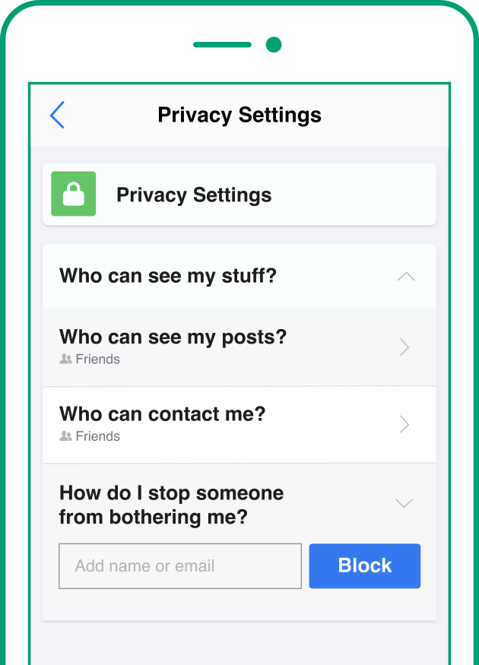
Children’s code
Privacy
      1
Children’s privacy setting should automatically be set
to high.
Notes:
Teacher notes
Privacy settings control who can see your posts and who can contact you.

Slide 13
Children’s code
Profiling
Profiling
      2
Profiling should be
turned off by default
on children’s accounts.
Profiling is when an app or website tracks a user’s online activity,
for example, what you buy or the videos you like to watch.
Notes:
Teacher notes
App notifications can be used to encourage you to spend more time on the app or to prompt behaviours, such as making in-app purchases.

Slide 14
Children’s code
Profiling
Profiling
Data usage
      2
Online companies use this data in lots of ways,
for example:
recommending new things to watch;
sending notifications encouraging users to buy things; and
showing adverts based on online activity.
Profiling should be
turned off by default
on children’s accounts.
Profiling is when an app or website tracks a user’s online activity,
for example, what you buy or the videos you like to watch.
Companies should not be profiling children unless it’s really needed.
Companies should give children
and young people choice about what data they share, and whether
they want to switch profiling back
on to receive notifications, advertisements or recommendations.
Notes:
Teacher notes
App notifications can be used to encourage you to spend more time on the app or to prompt behaviours, such as making in-app purchases.

Slide 15
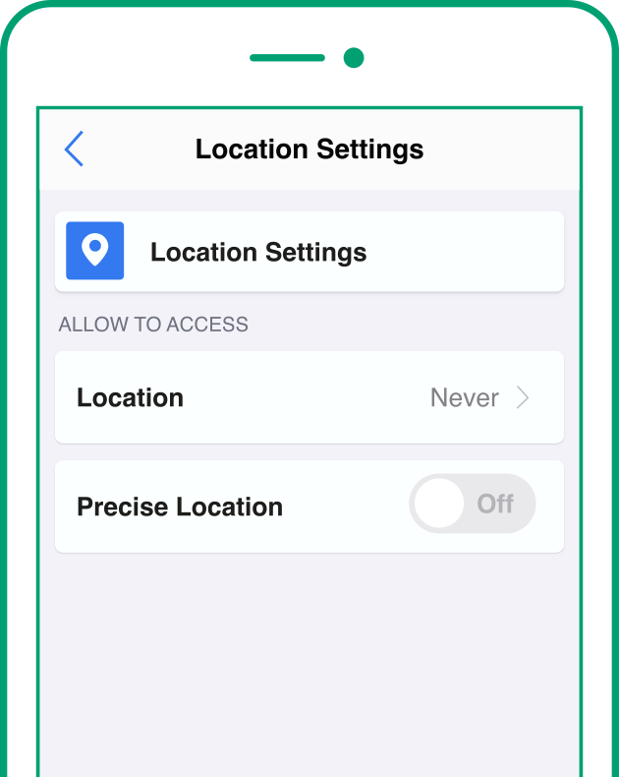
Children’s code
Location tracker
      3
Children’s location tracker should be automatically
set to off, unless it’s
really needed.
Notes:
Teacher notes
Apps shouldn’t be tracking children and young people’s location.

Slide 16
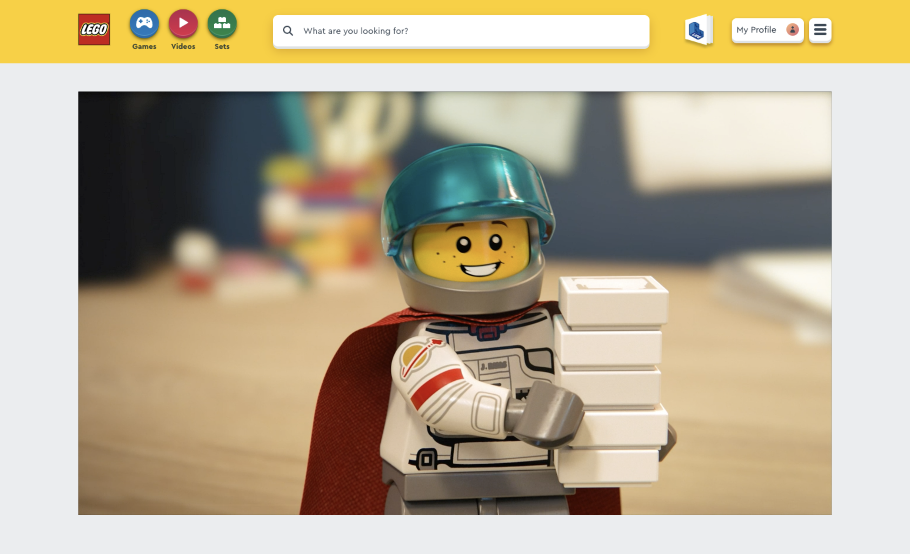
Children’s code
Privacy policy
www.lego.com/kids
      4
Websites, apps and games should explain how children’s personal data will be used in language that is simple and easy to understand.
      !
The Lego website uses a fun video to explain what happens to children’s personal data when they use the website.
This is called a ‘privacy policy’.
Notes:
Teacher notes
Some companies, such as Lego, have chosen to create videos that explain their privacy policy in easy-to-understand language.

Slide 17
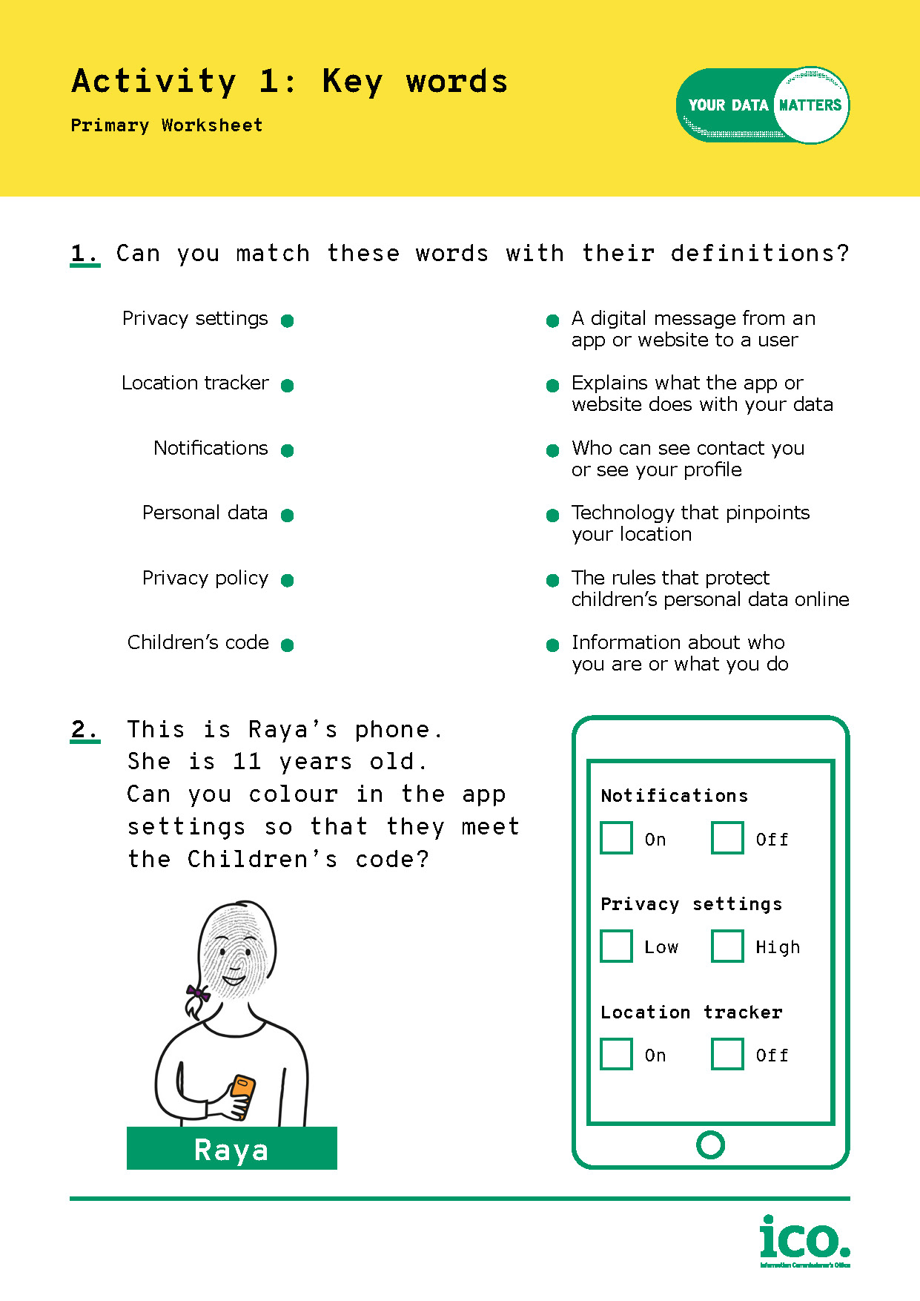
vv
Activity 1:
Key words
Can you match the key words to their definitions?
Work in pairs to complete the worksheet.
vv
Notes:
Children’s code worksheet
Pupils work in pairs to complete this short worksheet, reinforcing the key vocab covered in the session.
Pairs should swap worksheets to mark each other’s work as you talk through the answers.

Slide 18
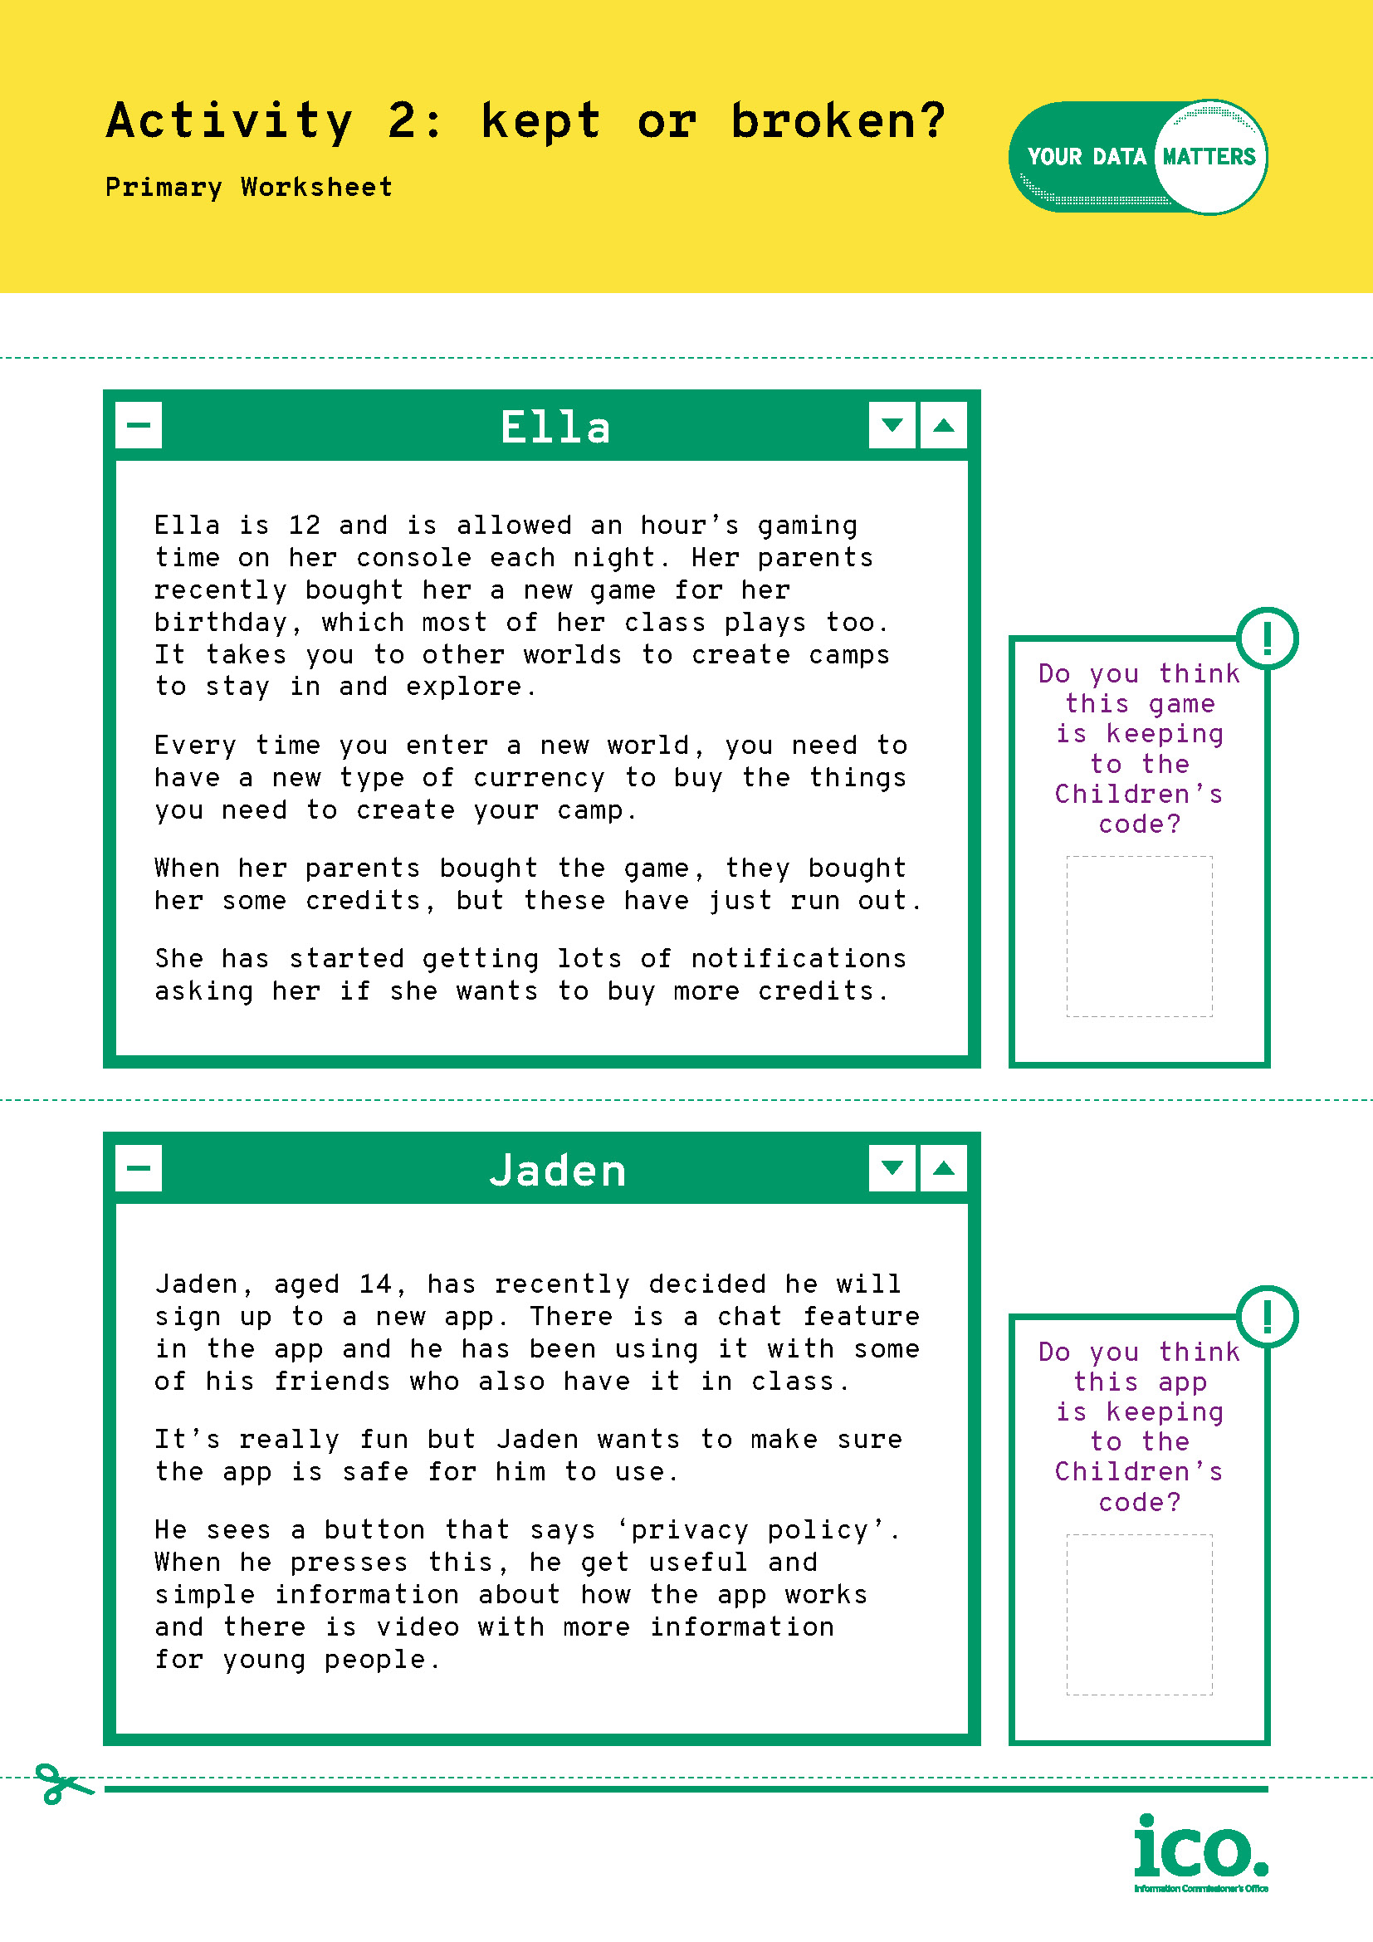
vv
Activity 2:
Code kept or broken?
In small groups, read through the stories and decide whether the app or game in each story is keeping to the code or breaking it.
Use the tick and cross stickers to show your group’s decision.
vv
Notes:
Code keepers activity
Divide the class into pairs or small groups. Each group should be given copies of the stories and a sheet with tick / cross stickers to cut out and glue to the stories once they have made their decision.
Do not display the next slide until the class has worked through the stories.

Slide 19
vv
Activity 2:
Code kept or broken?
In small groups, read through the stories and decide whether the app or game in each story is keeping to the code or breaking it.
Use the tick and cross stickers to show your group’s decision.
Activity 2: Answers
Noah’s game – Code kept
Shareen’s app – Code broken
Ella’s game – Code broken
Jaden’s app – Code kept
      ?
What would you advise Shareen and Ella to do in their situations?
      ?
How could Shareen’s app and Ella’s game be changed so that they don’t break the Children’s code?
vv
Notes:
Code keepers activity - answers
Talk through the answers on the slide and ensure that all pupils are clear on why each story meets or breaks the code.
Challenge questions, below, can be used to generate further discussion:
Noah’s game meets the Children’s code because his privacy settings are automatically set to high. Ask pupils why they think it is important that children and young people’s accounts are automatically set to high? (High privacy limits who can see your profile, including your personal information e.g. birthday, name, gender. This keeps you safer online and keeps your data more private.)
Shareen’s app breaks the Children’s code. It shouldn’t be using her location to advertise things to her. Her location tracker should be automatically turned off. Ask pupils to explain why they think the Children’s code says that location tracking should be turned off. (Your location counts as ‘personal data’, and therefore, online companies shouldn’t be using it without your permission.)
Ella’s game breaks the Children’s code because it shouldn’t be sending her notifications based upon profiling her account. She shouldn’t be pressured into making more purchases or using the game more.
Jaden’s app meets the Children’s code because it has a privacy policy that is written in simple language that’s easy to understand. Why do pupils think this is important? (It is important that apps and websites that are used by children and young people have privacy policies written in simple language, or accompanied by videos, so that young users can understand what is happening to their personal data when they use the platform.)
Q. What would you advise Shareen and Ella to do in their situations?
Shareen and Ella should talk to a trusted adult, parent or carer once they have realised that the apps they are using are not meeting the Children’s code. They may decide to stop using the apps altogether, or to adjust the settings so that they are no longer sharing their location data or receiving notifications. Shareen and Ella’s trusted adults may decide to contact the apps and let them know that they are not meeting the Children’s code. If the trusted adults are not happy with the response they receive, they can contact the ICO directly and make a complaint: https://ico.org.uk/global/contact-us/

Slide 20
Exit tickets
On your exit tickets write down:
one thing you have learned today; and
any questions you still have.
Remember, if you have any concerns about how a website or app is using your data talk to a parent or carer. Your parent or carer can contact the website or app.
      !
If your parent or carer is not happy with the response they get, they can contact the ICO for help: https://ico.org.uk/global/contact-us
Notes:
Plenary
As a plenary, hand out the exit tickets and ask pupils to write down one thing they have learned today and any questions they still have. Collect in the exit tickets as pupils leave the classroom and address any questions / issues at a later time.
If time allows, ask pupils to share what they have learned with the class before handing in their exit tickets.
Remind pupils that if they have any concerns about how a website or app is using their data they should talk to a parent or carer. Their parent or carer can contact the website or app with their concerns, and if they are not happy with the response they receive, they can contact the ICO for help: https://ico.org.uk/global/contact-us/
Thumbs up, thumbs down
If time allows, return to the learning outcomes and do a ‘thumbs up, thumbs down’ for each to assess how comfortable the class feel with each outcome at the end of the lesson.

Slide 21

Help and support
vv
vv
If you have any questions or concerns about this topic:
talk to your parent or carer about it;
have a chat with a teacher or member of school staff; or
take a look at the following websites:
    ico.org.uk
    nspcc.org.uk
    thinkuknow.co.uk
vv
Notes:
Don’t forget to send home the Children’s Code infographic to parents, to encourage pupils to continue the discussion at home.

