Slide 1
Can you afford a data breach?
Laura Middleton and James Hayward
Enforcement Team Managers
Notes:
Today we’ll be talking about the impact of data breaches on organisations, as well as some trends from data breaches that have been reported to the ICO recently, and some steps you can take to reduce the chances of your organisation experiencing a data breach of that nature.

Slide 2
WHO ARE WE?
Notes:
The ICO is the UK’s independent authority set up to uphold information rights in the public interest. We promote openness by public bodies and data privacy for individuals.
The ICO regulates the Data Protection Act and Freedom of Information Act, and other associated pieces of legislation.
The Data Protection Act (DPA) has eight principles of good information handling. These give people specific rights in relation to their personal data and put certain obligations on those organisations that are responsible for processing it.
When we talk about a data breach we’re looking a potential breach of the seventh data protection principle. This requires data controllers to have measures in place to protect against unauthorised or unlawful processing of personal data and against accidental loss or destruction of, or damage to, personal data.
Many organisations choose to self-report potential breaches of the seventh principle to the ICO.

Slide 3
Notes:
We conclude many cases informally, by providing advice and guidance to data controllers. We may make recommendations for improvement, and we may ask you to write back to us after a period of time, to let us know how you’ve got on with implementing our recommendations.
Our investigators work closely with our Good Practice team. Often, particularly if an organisation is experiencing a large number of data security incidents, or the reasons for these are particularly varied, we’ll ask the Good Practice team to provide you with some help. This allows us to provide tailored advice to your specific organisation and set of circumstances. This service is free! So if you’re offered the opportunity to have an audit, advisory visit or some other input from our Good Practice team, it’s well worth considering.
Where we consider an organisation to be in breach of the DPA, we may ask it to sign an undertaking, to commit to making improvements in its data protection practices.
An enforcement notice is similar, but this is more formal as breaching an enforcement notice is a criminal offence.
We have the power to serve civil monetary penalties of up to half a million pounds for the most serious breaches of the DPA. The maximum amount of a penalty will rise significantly once the new General Data Protection Regulation comes into force in May 2018.
Case examples where the ICO has served penalties, enforcement notices and undertakings on data controllers can be found on the ICO website.

Slide 4
Is personal data valuable?
Notes:
Is personal data valuable? Yes, it is!
We expect those who we trust with our personal data to keep it safe. Personal data should be protected in the same way as money, or physical assets. If organisations don’t treat data in this way, the results can be catastrophic.
For example, we served a penalty to an organisation that had disclosed in error the address of an adoptive family, to the birth family in a contested adoption case. The disclosure caused a great deal of distress to the adoptive family.
There is also an impact on the staff members whose actions caused the breach – imagine being the staff member who sent out that information in error. In that case, there was no clear process for the staff member to follow when sending information to the birth family under what is known as the ‘letterbox’ arrangement. The staff member had the best of intentions – she thought the letters needed sending as a matter of priority – they didn’t. The mistake occurred because the data controller didn’t give the staff member sufficient guidance as to how the information needed to be sent.
There is a reputational cost to an organisation that suffers a data breach – regaining the trust of customers can be difficult.
A data breach could cost your organisation half a million pounds. So it’s worth investing in preventative measures and treating personal data as something of value.

Slide 5
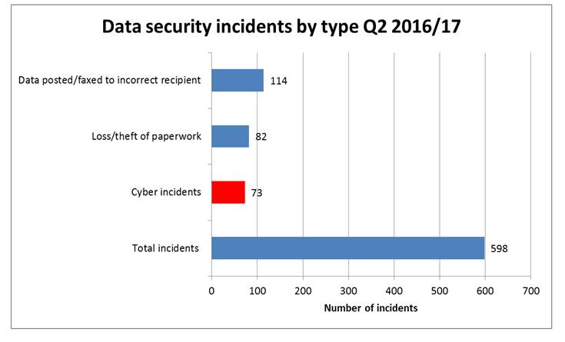
Notes:
So, where might you want to focus your efforts?
There were a total of 598 data security incidents reported to the ICO in the second quarter of this financial year. There has been a lot of interest in relation to cyber incidents recently, and 73 of these reports related to cyber incidents – such as hacking, misconfiguration and denial of service attacks. Cyber risks don’t just affect large companies like TalkTalk, who received a £400,000 fine in September. These risks are present for any data controller who holds personal data electronically.
We were asked recently whether data controllers will ever be able to keep up with the attackers – or will they always lag behind. An important thing to take from today is that most of the technical attacks we have seen have not involved state of the art technology. They’ve been straightforward attacks that the data controllers could have prevented fairly easily.
Cyber incidents are on the increase by we mustn’t lose sight of other key areas of risk. Data posted or faxed to incorrect recipients and the loss or theft of paperwork are the most common incident types reported to the ICO.
All of these issues are boardroom issues. They need to be addressed from the top, by embedding a culture of data protection compliance within organisations.

Slide 6
Human error?
Notes:
Quite often, when we carry out an investigation and we ask an organisation what has gone wrong, they tell us that it’s just human error.
The actions of an individual will almost always be the last step in the chain before a data breach occurs.
What the ICO looks at, is what was or should have been in place to prevent the incident occurring in the first place.

Slide 7
Organisational Measures
HUMAN ERROR
Awareness
Technical measures
Notes:
Organisational measures might include:
Physically securing buildings, servers and equipment. We have cases reported to us where NHS staff have left smartcards in computers and then left their workstation unattended. Patients have then taken the opportunity to access other patients’ records.
Policies and procedures – these are really important to help staff understand what how they need to handle data. But – we know that staff are really busy. Be mindful that they may not read a long, overarching data protection policy. Checklists can be really helpful. In the adoption case mentioned earlier the data controller implemented a checklist for staff to follow when sending out information under the letterbox arrangement, as a remedial measure.
Roll out measures consistently. We have seen examples of organisations having software available to allow finance departments to redact information prior to publication, but other departments have been resorting to using black marker pen where the data is visible once the pen dries.
There are various technical measures you might want to make use of. There are perhaps some overlaps with policies and procedures here, and you might want to introduce policies to support technical measures. For example:
Encryption is a technical measure. The ICO has been very clear about emphasising the need for portable devices to be encrypted. However, the encryption is only a useful security measure if the encryption key is stored separately to the device. You might want to have a policy to make this clear to staff.
File access controls – but should you have a secondary check in place whenever permissions are changed to guard against errors?
Email controls – for example, removing the Autocomplete feature from Outlook to reduce the number of emails being sent to the wrong place. This will reduce errors but staff should still ensure they’re selecting the correct recipients from their address books.
Awareness is really key. If staff members aren’t aware of the need to protect data, data controllers will struggle to achieve compliance. Awareness can be raised by:
Providing training to staff members – both on induction and then refreshed regularly. We know that training is a big commitment, so if data controllers can’t provide refresher training for everyone once a year, which is what we’d recommend, they should consider areas of high risk. They should also ensure that training is tailored to the staff members and the roles being undertaken. Someone working in Finance may need different training to someone working in Children’s Services.
Keeping data protection alive between formal training sessions – for example by using posters, articles in newsletters, email reminders.
If you do have an incident, take the opportunity to learn from it. Mistakes often make the best case studies! Sharing what’s gone wrong, and how others can avoid a repeat – perhaps in team meetings – can be a really valuable exercise.
The idea is to reduce the potential for human error by increasing the measures a data controller can take to protect data.
That way, the data controller will be able to say that they’ve taken all reasonable measures.

Slide 8
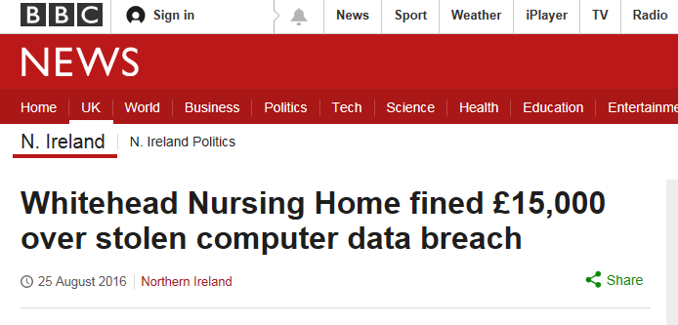
Notes:
Talk Talk
Cyber case
150,000 affected customers.
Fine of £400,000 from the ICO.
Basic facts of the case:
In 2009, Talk Talk bought the UK operations of Tiscali. As part of the deal, Talk Talk acquired Tiscali infrastructure, which included webpages. One of the webpages contained a database which detailed information about Tiscali customers.
Between 15 and 21 October 2015 these webpages suffered a cyber attack. Personal data related to 150,000 people was extracted. For 15,000 customers this included banking information.
What the ICO found:
There were failings on behalf of Talk Talk:
Talk Talk were unaware that Tiscali’s infrastructure included webpages which were still available via the internet in 2015, including the database which was accessed.
Talk Talk failed to remove the webpages from the internet.
The database software which was attacked was outdated. If updates had been applied to the database, cyber attacks would not have been able to take place.
What Talk Talk could have done
Talk Talk could have taken the following steps:
They could have removed the database from the internet, removing the possibility that it would be open to attack.
Better understanding of information assets.
Talk Talk could have updated the database software. They were vulnerable to an SQL injection attack. Such attacks are preventable if software is kept up to date with the most recent patches.
What does this mean for your organisation?
Where you use database software, especially on your website, ensure that there is a schedule to ensure that software is kept up to date.
Consider creating an Information Asset Register. If you understand the information you hold you will be in a better position to protect it.
Whitehead Nursing Home
The case concerns the loss of an unencrypted laptop.
Data relating to 29 nursing home residents and 46 staff was on the laptop.
The ICO issued a penalty of £15,000. This reflected the size of the organisation. A larger organisation experiencing a breach of this type should expect to receive a higher penalty.
Basic facts:
The nurse manager at the nursing home had been provided with an unencrypted laptop. The laptop was used at work, but the nurse manager also took the laptop home, to finish off work. The laptop was stolen during a burglary at the nurse manager’s home.
What the ICO found:
The nursing home didn’t really have anything to prevent a breach. It issued the unencrypted laptop in the first place, and it didn’t have any policies or procedures in place around the encryption of mobile devices, or homeworking. It didn’t provide data protection training for its staff. So whilst they were used to respecting the confidentiality of patients, this didn’t give them sufficient awareness of the requirements of the DPA.
What Whitehead Nursing Home could have done:
It could have given consideration to what equipment its staff needed. If a laptop was issued, it should have been encrypted – laptops are always attractive to thieves, so there’d be a risk one could be stolen from the home itself, and because they’re portable, it’s always possible that staff will take them home, even if the organisation doesn’t expect this. Think about the impact on staff members involved in incidents. The nurse manager in this case may have thought they were being diligent in taking the laptop home so they could finish off work – their employer should have removed the risk of the data being lost.
What does this mean for your organisation?
You need to think about the data you’re processing and how you’re processing it. What do you need to put in place to protect that data? Make sure you have a data protection policy to set out your expectations about how data needs to be handled.
By raising staff awareness of data protection requirements, they can help organisations pinpoint weaknesses in DPA compliance. If Whitehead had trained their staff, one of them may have questioned whether the data on the laptop was safe, which may have prevented the data loss.
Chelsea and Westminster Hospital NHS Trust
Disclosure in error case.
700 data subjects.
Fine of £180,000 from the ICO.
Basic facts of the case:
56 Dean Street is a sexual health clinic which is part of the Trust.
The clinic provides services to patients with HIV. One service the clinic provided allowed patients to receive medical results by email.
The email addresses in use for the service were also used to distribute ‘round robin’ emails related to the clinic. One of these round robin emails was sent with all the email addresses in ‘to’ rather than ‘bcc’. This took place in September 2015.
When the email was sent out it revealed all the email addresses of people on that mailing list. This had the effect of revealing, or at least alluding to, the HIV status of patients on the emailing list. The ICO and the trust received many complaints from affected individuals who were extremely distressed that their personal data had been disclosed in this manner.
What the ICO found:
There were several failings found on behalf of the trust:
There was a similar incident in the past where other patients receiving HIV treatment had their email addresses revealed. This took place in 2010, and affected 17 people. The trust’s remedial action failed to prevent the subsequent incident.
Patients who had agreed to receive medical results by email had not agreed to receive round robin emails. It was worrying that people had not consented to receiving these emails.
There was nothing wrong with the medical results service, but the Trust had not fully considered the risks to personal data before the service was set up.
What the Trust could have done
Here’s what the trust could have done:
Completed a Privacy Impact Assessment before their new electronic system was implemented. A Privacy Impact Assessment allows organisations to consider all the risks to personal data before a new project is implemented.
Provided an email service which allows for round robin emails to be sent by BCC automatically.
Provided better training to staff to explain some of the risks associated with group emails and how to mitigate against them.
What does this mean for your organisation?
If you are embarking on a new project which involves personal data consider all the risks to the data before you implement it. Use a Privacy Impact Assessment to help.
Wherever group emails are used ensure that no personal data will be put at risk. Consider using a special program which will not reveal individual email addresses.

Slide 9
Is personal data valuable?
Notes:
Personal data is valuable.
It’s valuable to the data controller – without it, they wouldn’t be able to conduct their business or perform their functions.
It’s valuable to the individual the data is about – particularly if the data is confidential, like bank details, or sensitive, such as health information.
And failure to protect it can be costly.

Slide 10
Keep in touch
Subscribe to our e-newsletter at www.ico.org.uk
or find us on…
@iconews

