Slide 1
Corporate Affairs report
Quarter 1, July 2016
Management Board

Slide 2
Headlines
Christopher Graham on Today, BBC Breakfast and BBC News, with Steve Eckersley on local radio stations, as DCMS change law around withheld call ID
1,100 people tune into ICO webinars… Twitter followers up 7%... e-newsletter subscribers up to 90,000… 80% of visitors are positive about ico.org.uk… 500,000+ page views on ICON…
The annual report is laid, and launched in London, as Brexit dominates discussions
Christopher Graham says farewell to the ICO

Slide 3
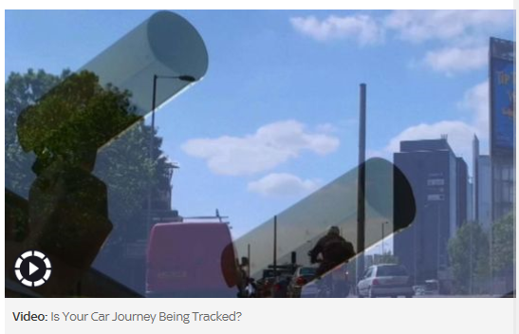
Media coverage
Local and national coverage around fines for Kent Police, Blackpool Teaching Hospital NHS Trust, Chelsea and Westminster Hospital NHS Foundation, Better for the Country and Nevis Homes, plus Jonathan Bamford is interviewed by Sky News about ANPR…

Slide 4
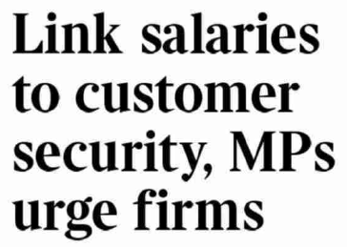
Our work in the headlines
A Select Committee report into cyber security is covered across the media, a high profile FOI decision gets coverage in the sport pages, and an interview with Christopher focuses on PECR powers:

Slide 5
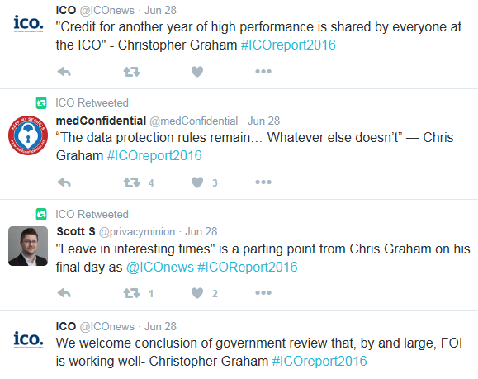
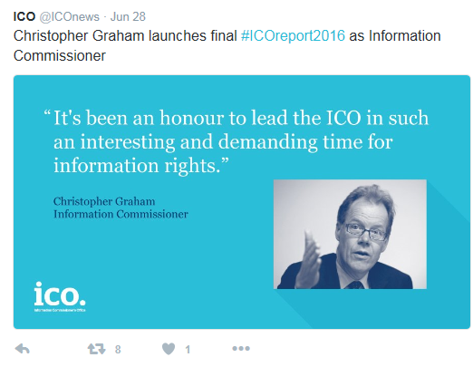
Annual report launch
The ICO annual report launch took place on 28 June at Sixty One Whitehall, London. This marked Christopher Graham’s final annual report as Information Commissioner and we received applications from over 120 stakeholders to attend this event.
Delegates tweeted using #ICOreport2016

Slide 6
Other events and conferences
The ICO SME Conference was held at the NEC Birmingham in April. Over 300 delegates attended across two half day sessions, with workshops on subject access, information security and records management.
In addition to the ICO led events that we organise, we also help arrange our attendance at other trade exhibitions in various sectors. Two examples in Q1 were:
Members of the Good Practice team attended the annual conference of the Information and Records Management Society (IRMS) in Brighton. The conference was an opportunity for the ICO to promote the SME self-assessment toolkit.
Colleagues from Strategic Liaison attended the Chartered Trading Standards Institute conference in Telford, with a view to helping Trading Standards identify where there may be issues of concern to us in the course of their investigations, and encouraging them to take their own action where they can.

Slide 7
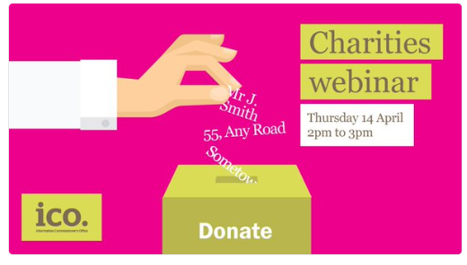
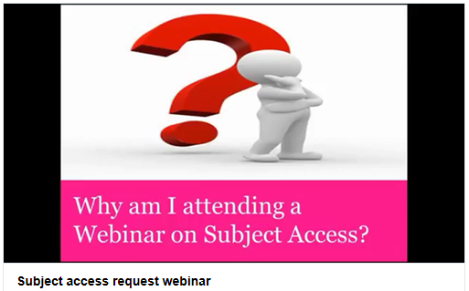
Webinars
Webinars allow us to reach a large audience, without staff needing to dedicate large amounts of time to organising events or travelling to London etc.
More than 350 people tuned into our charities webinar in April, while 760 were part of our subject access webinar in June. We’ve got more lined up for the coming months
The webinars are recorded, and can be viewed as videos after the event. Our subject access request webinar has had 800 views since it was published in May.

Slide 8
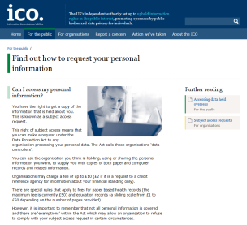
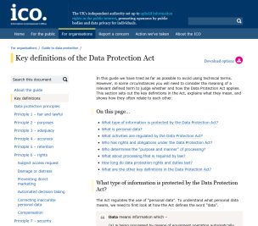
ico.org.uk
Pages with most views, Q4
For the public
Find out how to request your personal information 56,500 page views
Thanks message (after reporting a nuisance call)
24,000 page views
3. CCTV
24,000 page views
For organisations
Guide to data protection
134,000 page views
2. Key definitions
110,500 page views
3. Registration page
95,000

Slide 9
Who uses our website? Our 2016 website user survey was completed by more than 1,700 people who visited ico.org.uk in May - June.
48% had reported nuisance calls or texts to us
50% of people from organisations were private sector, with 37% in the public sector
14% of people looking for guidance and advice wanted info on GDPR reforms
2% were
aged 16-24
13% came to the website to find out about action taken by the ICO
What guidance do organisations look at?
6% of visitors want to register or renew their registration

Slide 10
What do they think of our website?
80% got everything they wanted from their visit to our website
84% thought the security of the service was very good or good
85% rated the accuracy and relevancy of info on the site a good or very good
69% who used the search function thought it helped them find what they were looking for
80% were satisfied or very satisfied with their visit

Slide 11
Twitter
Our 16,164
followers see our tweets…
An impression is when a tweet is seen by someone, either because they follow us or they’ve seen a retweet.
Our tweets got 1.8million impressions last quarter
(up 7% on last quarter)
We got 25,000 referrals to our website from social media in Q1:
Twitter Facebook LinkedIn Others (inc Reddit)
10,418 8,176 5,806 547

Slide 12
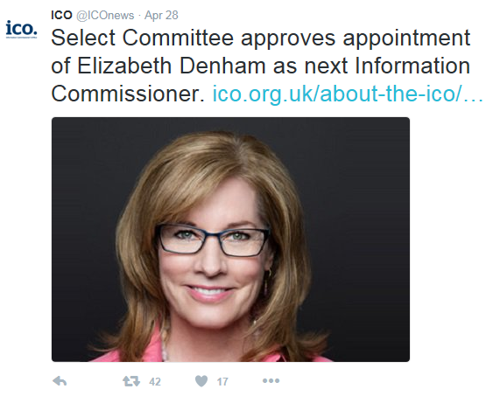
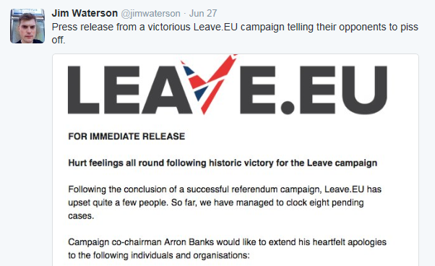
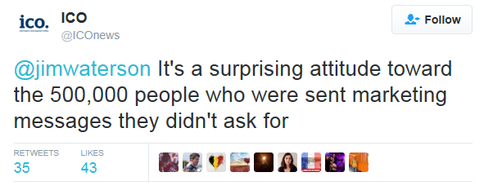
Most retweeted stories
1st
Referendum result response: 102 retweets, 34 likes
2. Select Committee approves appointment of Elizabeth Denham 42 retweets, 17 likes
3. Response to Leave.EU’s ‘ICO – Whatever’ press release
35 retweets, 43 likes

Slide 13
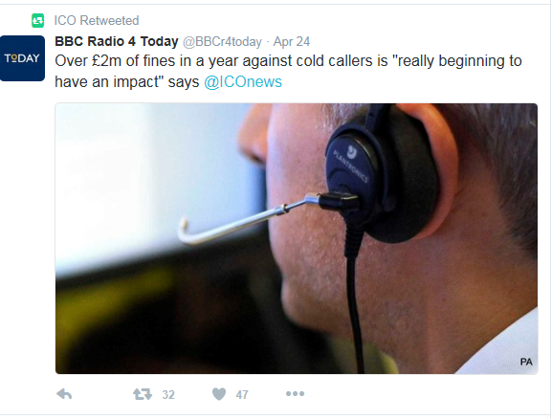
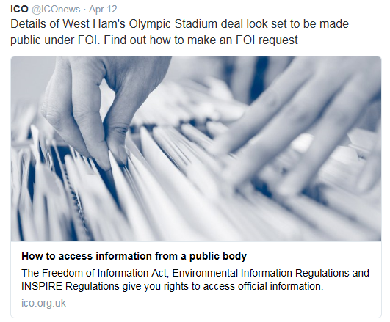
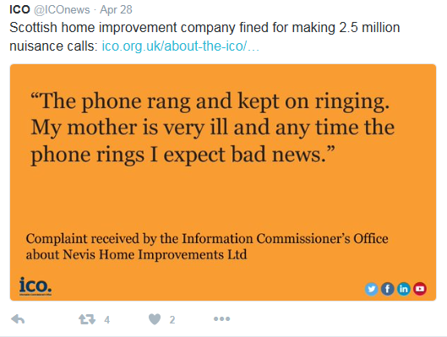
Other Twitter highlights
Positive tweet about ICO’s work by influential BBC Radio 4 Today programme, which has half a million followers.
The introduction of ‘Twitter cards’ means tweets with links to many of our webpages will automatically include images. Tweets with images typically prompt more engagement than those without
Using images of complaints to show the real annoyance of nuisance calls

Slide 14
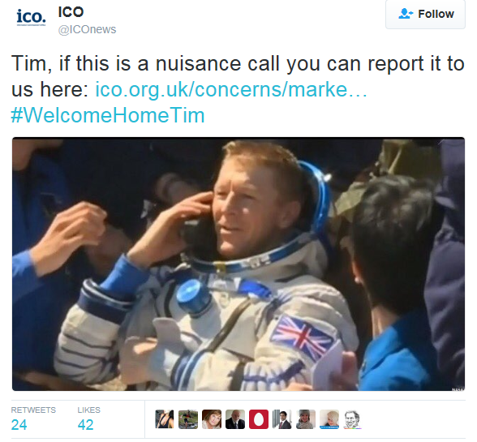
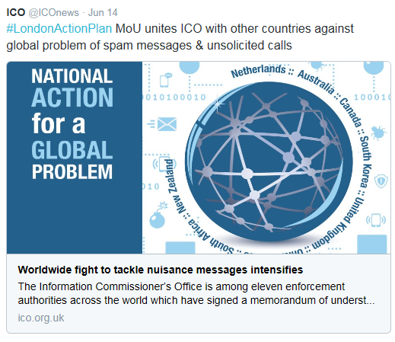
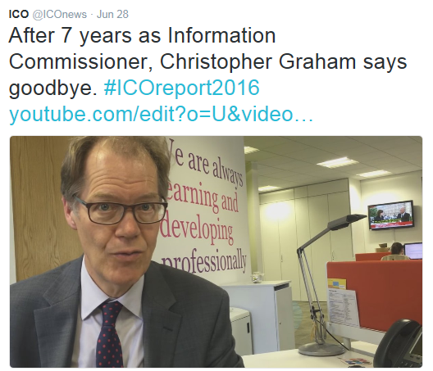
Other Twitter highlights
Supporting international comms work to highlight joined-up approach to nuisance calls… A farewell video from Christopher Graham… Live tweeting from the ICO’s Scottish DPO Conference…
And finally, a well received tweet as Tim Peake returns from the International Space Station

Slide 15
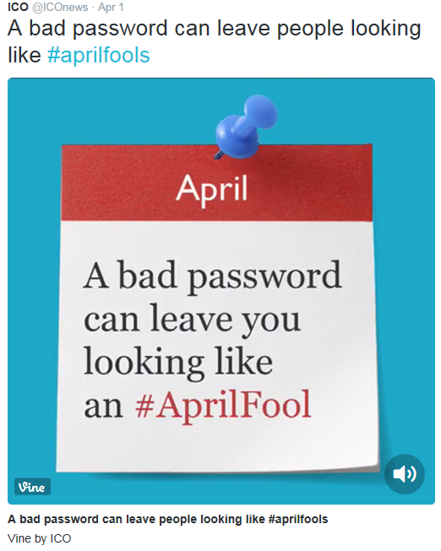
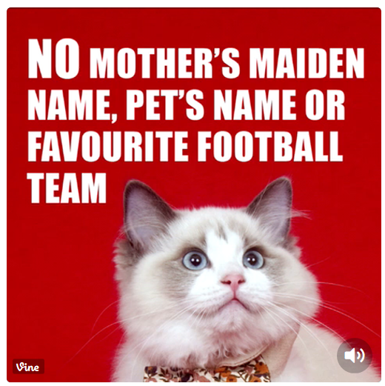
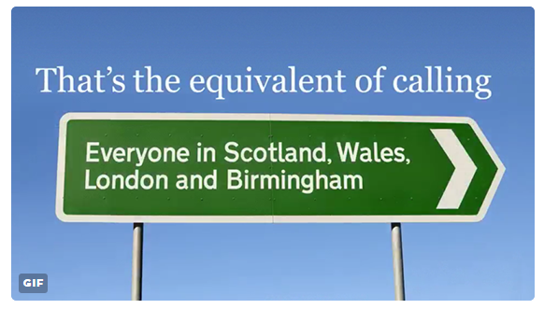
Vines
Using Vines on Twitter means we can give more detail than would otherwise be possible. Our vines have so far had 55,000 loops

Slide 16
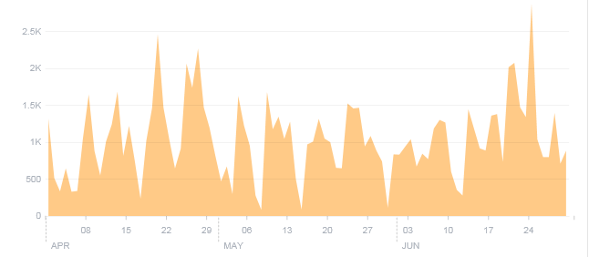
Facebook LinkedIn
Our Facebook presence continues to be strong. 27 of our posts this quarter reached more than 1,000 people.
Referrals to our website from LinkedIn rose 141% in the last quarter, with 5,806 users clicking through to ico.org.uk
We have more than 7,000 followers on LinkedIn. This is up 138% from July 2014.
The referendum result prompted the biggest spike this month, followed by a post about taking photos of children in schools, how social networks use personal info and a post on encryption.

Slide 17
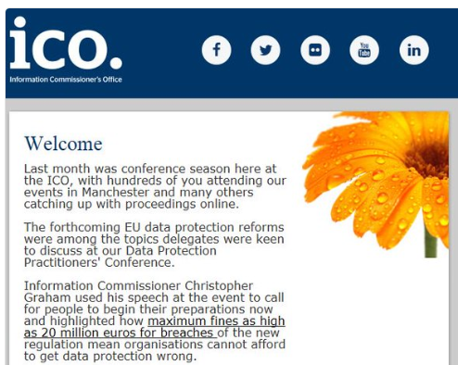
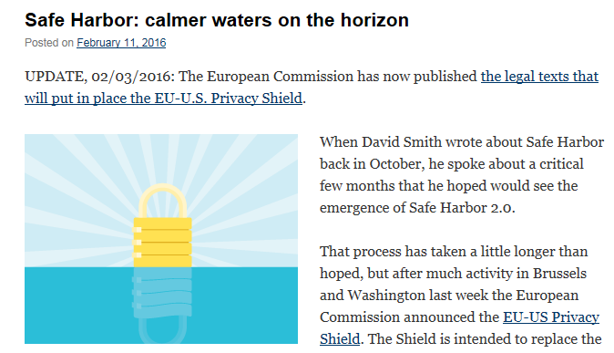
Newsletter Blog
Our monthly newsletter has 90,000 subscribers. The most popular stories this quarter were:
What to expect from the GDPR
12 steps to prepare for the GDPR
Sign up to our SAR webinar
Our blog has had 50,000 visitors this year. The most popular posts have been on:
Safe Harbour
GDPR tips
Encryption guidance (inc short videos)

Slide 18
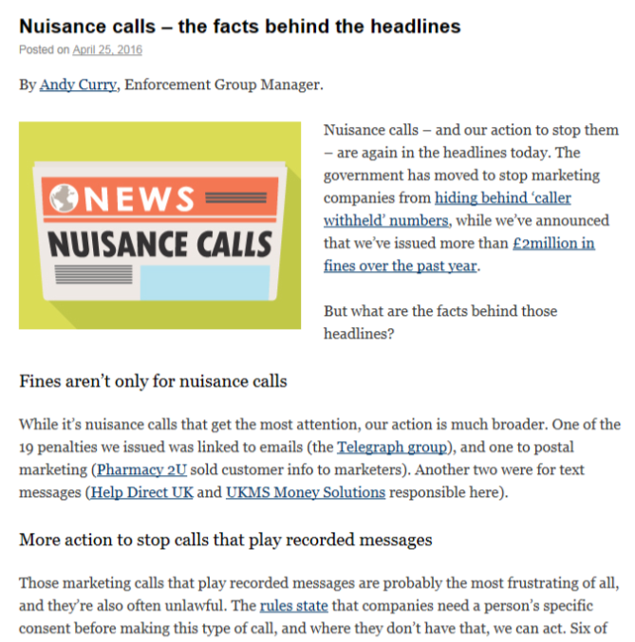
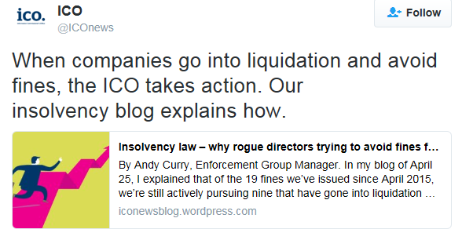
Critics: are ICO fines effective?
By monitoring social media, we were aware of potential criticism of the ICO around having issued £2m of nuisance call fines, but only £165k has been paid.
We wanted to get on the front foot:
We published a blog on ‘the facts behind the headlines’ that highlighted the problem, in context
We arranged a guest blog, with a an insolvency practitioner explaining the tough laws around avoiding fines by going bankrupt

Slide 19
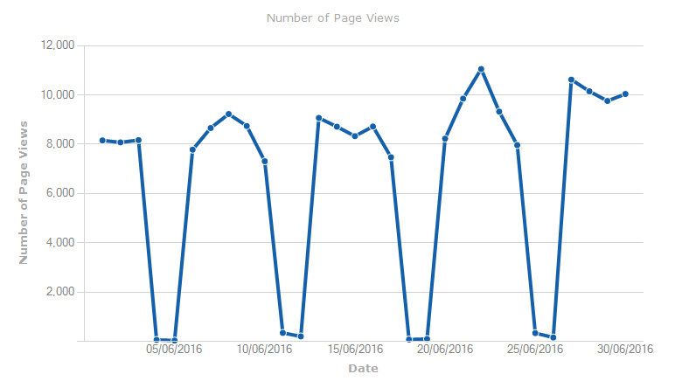
ICON
28 June: annual report
27 June: Chris announces interim Deputy Commissioner
553,605 page views in Q1, ↑ 1% on
Q4 2015/16
Top news stories:
A thank you from Chris, 30 June
2. Informer (June)
3. Annual report save the date
4. Informer (April)
5. Annual report published
1st
ICON typically gets more than 8,000 page views a day. The number of views generally reflects the number of people in the office, with peaks mid week, and very low figures at weekends.

Slide 20
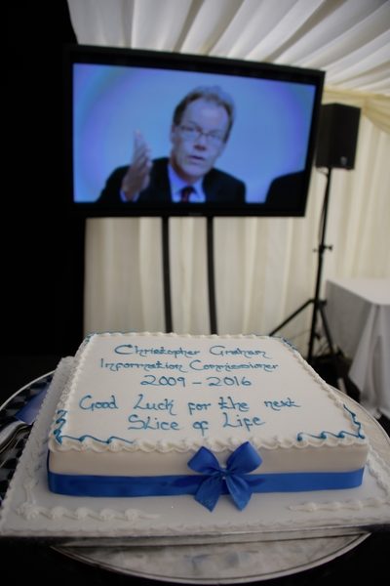
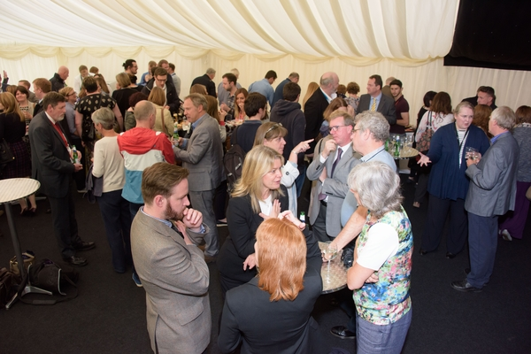
Internal communications
Initial results from the staff survey show 95% of staff say they have good relationships with colleagues, 88% say the people they work with are willing to help, but just 11% feel their pay is fair
The ICO supported Carers Week, with a piece from Mike Collins on ICON, and posters and flyers across the offices.
Farewell to Chris Graham at a marquee event for staff
Dyslexia Action named ICO charity of the year, following staff consultation. ICO football tournament and Euro2016 fundraising in June brings total raised for Dyslexia Action to £1,750.

