Slide 1

Data Breach Management
Workshop
Data Protection Practitioners’
Conference 2019
#DPPC2019

Slide 2
Introductions
Data Protection Practitioners’
Conference 2019
#DPPC2019

Slide 3
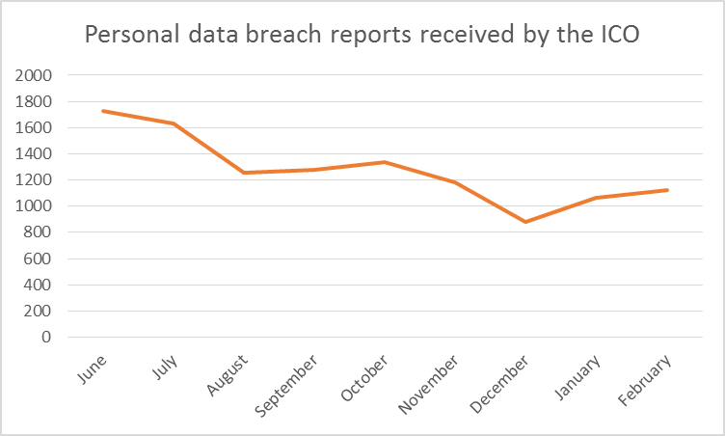
ICO experience of breach reporting
Data Protection Practitioners’
Conference 2019
#DPPC2019
Notes:
People are always interested in the number of breach reports we have received, so we thought we’d share this with you. As you can see, the first couple of months following the implementation of the GDPR resulted in a high number of breaches being reported: around 1700 to 1800 each month.
⁃ By later in the summer this had settled to between 1200 and 1300 breach reports per month. This wasn’t a seasonal blip but represented a levelling off.
⁃ December is always an anomaly; with many organisations closing down or running on a skeleton staff for at least part of the month, we’d expect fewer breaches to occur and therefore fewer breaches to be reported to us!
⁃ As you can see, by February we’ve returned to within range of the number of reports submitted in the Autumn.
⁃ We think the large number of reports in the summer is due to controllers being overly cautious, or perhaps not fully understanding their obligations
⁃ Increased controller awareness of new legislation and the fact there was a requirement to report, which was good, but perhaps not a full understanding of what to report
⁃ Raised profile of the ICO
⁃ Controllers not sure/uncomfortable with assessing whether a breach needs to be reported – risk of a big fine if we get this wrong?! We’ll report anyway so we don’t get into trouble.
⁃ Article 33 doesn’t require every breach to be reported but some breaches are still being reported by controllers even if they feel that a breach doesn’t need to be reported. We’ve changed our breach reporting form to add an option for you to select if you are doing this - so we can best decide how to manage and prioritise our workload.
⁃ What we’ve been doing to help – educating through advice line, advice on cases, webinar in the summer which is still relevant and still available on the ICO’s website. This includes some top tips in relation to breach reporting
⁃ We’ve recently launched a new self-assessment tool which is available on our website. It has three simple questions so it shouldn’t take you long to get the steer or reassurance that you’re looking for, and there’s the PDB advice line if you’re unsure whether to report.
⁃ One thing to note: I know that people were ringing us in May last year and experiencing long delays on the phones. That was due to very high demand at the time, but it’s a thing of the past, so don’t let that put you off calling.

Slide 4

The exercise
Data Protection Practitioners’
Conference 2019
#DPPC2019
Notes:
- We sent you a scenario to read in advance, so hopefully everyone’s done that. If you haven’t brought your copy or you need a refresher, there’s a timeline of events on your table
⁃ Breach management is a big topic to cover in 40 minutes so we are going to move through the questions at pace to make sure we cover all the essentials
⁃ We’ll be asking you to indicate what you would do using Slido - you were sent instructions on how to use this in advance but if you need help let the ICO rep on your table know
⁃ There’s a bingo card on your table - as you we go through you might like to mark up which articles of the GDPR you think have been infringed
⁃ We’re not going to have time to take general questions but there is a breach reporting stand at the information market so please do go and see the team there and they’ll be happy to talk to you
⁃ If you’ve been on Slido you may have seen there’s a facility to ask questions there. You can do that but we won’t be able to respond individually. But if there are common trends we may add a Q&A document to the website or feed the questions into future guidance

Slide 5
What measures do the audience believe the Controller should have had in place to deal with this incident?
A - Breach logs (article 33).
B - Incident reporting procedure (inform DPO).
C - Retention schedules.
D - Checking processes (before upload).
E - Staff training.
F - 72 hour awareness (article 33).
G - All of the above.
Notes:
CORRECT / ANTICIATED ANSWER: G – ALL OF THE ABOVE
Breach logs must be maintained, ICO can and does ask for these – but they are principally an important tool for you and can help you spot patterns of non-compliance and areas that need additional attention;
Your incident reporting procedure is your first line of defence. Consider carefully the role of the DPO and the requirements of Article 38 (position of the data protection officer) – it will benefit you for their involvement to be immediate, both in recovering & remediating the situation and in demonstrating compliance;
If checking procedures were in place, might this process have been avoided? What sort of checks should have been in place? Should they have been the same or similar to those in place for uploads to external facing sites?
Staff training is absolutely key. The ICO will nearly always ask about this and expect to see evidence that it has been delivered and is of an appropriate standard;
The ICO closely monitors the extent to which DC’s are meeting the 72 hour reporting requirements. Be aware that a late report or a failure to report altogether, could attract a tier 1 fine of 2% or 10 million Euro;

Slide 6
Should the controller inform affected data subjects (article 34)?
A - Yes
B – No
Notes:
CORRECT / ANTICIATED ANSWER: A – Yes
Art 34 requires that
‘When the personal data breach is likely to result in a high risk to the rights and freedoms of natural persons, the controller shall communicate the personal data breach to the data subject without undue delay’.
In this scenario, the ICO would expect you to inform DS’.
-One of the considerations here is that Medical history; Ethnicity and Disciplinary records are affected, and are highly likely to be damaging to those affected.
-Whether to inform can be very context driven.
-One of the other considerations for you is much more practical – if it effects employees/ex-employees you have a greater opportunity to put out relevant messaging and to contain and remediate the incident.
-Once the media is aware of the story, your opportunity to ensure that your key messages for affected data subjects and your ability to concentrate on remedial and containment measures may be lost.
-Remember that the ICO can require a data controller to inform data subjects in certain circumstances.
-There are circumstances where notification is not required / appropriate – for example, carve outs for national security/law enforcement. See also Art 34 (3):
The communication to the data subject referred to in paragraph 1 shall not be required if any of the following conditions are met:
-the controller has implemented appropriate technical and organisational protection measures, and those measures were applied to the personal data affected by the personal data breach, in particular those that render the personal data unintelligible to any person who is not authorised to access it, such as encryption;
-the controller has taken subsequent measures which ensure that the high risk to the rights and freedoms of data subjects referred to in paragraph 1 is no longer likely to materialise;
-it would involve disproportionate effort. In such a case, there shall instead be a public communication or similar measure whereby the data subjects are informed in an equally effective manner

Slide 7
Is the incident reportable to the ICO (article 33)?
A - Yes
B – No
C – Maybe
Notes:
CORRECT / ANTICIATED ANSWER: A – Yes
The ICO would expect the incident to be reported in reflection of the fact that a data breach has taken place and that this is likely to have affected the rights and freedoms of data subjects,
It should be reported in 72 hours of ‘becoming aware’;
If not made in 72 hours, it should be accompanied by reasons for the delay.
Art 33 requires that
Art 33: ¹In the case of a personal data breach, the controller shall without undue delay and, where feasible, not later than 72 hours after having become aware of it, notify the personal data breach to the supervisory authority competent in accordance with Article 55, unless the personal data breach is unlikely to result in a risk to the rights and freedoms of natural persons. ²Where the notification to the supervisory authority is not made within 72 hours, it shall be accompanied by reasons for the delay.

Slide 8
At what point should the incident be reported to the ICO?
A – When spreadsheet was first uploaded (10am on the 1 April).
B – When the excess information contained in the spreadsheet was first noted by a member of staff (11am on the 1 April).
C – When the spreadsheet was removed (12:30pm on the 1 April).
D – When it was agreed an apology to staff will be uploaded to the intranet (12:30pm on the 3 April).
E – When the DPO was informed, and confirms the existence of a pivot table (2:30pm on the 3 April).
F – When the journalist contacts the firm asking for a comment.
Notes:
CORRECT / ANTICIPATED ANSWER: B or E.
The key message that we want to get across here is that context is essential. If it’s an organisation where pay and grade are published routinely by the organisation and there are no Gender Recognition Act matters arising, the impact on the rights and freedoms of natural persons might not present a risk to a level that would require notification;
However, at point E, which is where the existence of Medical history; ethnicity & disciplinary records is revealed to have been affected notification to the ICO would be expected;
There are some carve outs from the requirement to notify, for example in relation to certain national security matters (DPA2018 – s108 (6)Subsection (1) does not apply in relation to a personal data breach if the breach also constitutes a relevant error within the meaning given by section 231(9) of the Investigatory Powers Act 2016);
Art 33 requires that
¹In the case of a personal data breach, the controller shall without undue delay and, where feasible, not later than 72 hours after having become aware of it, notify the personal data breach to the supervisory authority competent in accordance with Article 55, unless the personal data breach is unlikely to result in a risk to the rights and freedoms of natural persons. ²Where the notification to the supervisory authority is not made within 72 hours, it shall be accompanied by reasons for the delay.

Slide 9
Which action do you think should be the first priority?
A – To inform the ICO
B – To inform staff
C – To secure the data
D – To take action against the member of staff concerned
E – To deal with the media enquiry
F – None of the above
Notes:
CORRECT / ANTICIATED ANSWER: C
Securing the data from further harm and containing the incident should be the first priority

Slide 10





Keep in touch
Subscribe to our e-newsletter at www.ico.org.uk
or find us on…
/iconews
http://ico.org.uk/livechat
@iconews
Data Protection Practitioners’
Conference 2019
#DPPC2019

