Slide 1
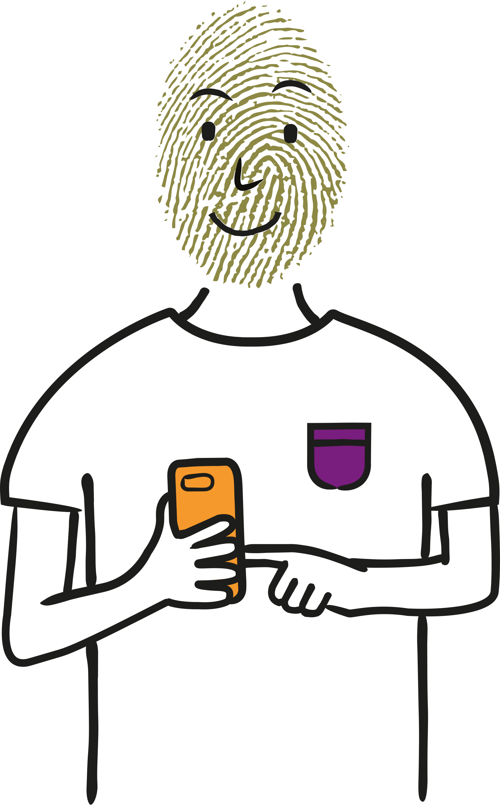
Staying Private on Social Media
Understanding how your data is used on social media
Age group 9-11

Slide 2
Staying Private on Social Media (Wales)
This lesson aims to make students aware of what personal data is, how it is collected and how it is used. It can be used as a standalone session but is recommended to be used with the previous session, ‘My Personal Data’.
Age: 9-11
Timing: 50-60 mins
Learning objectives:
Students will learn:
How social media platforms can use your personal data.
The risks associated with a public social media profile.
What a digital footprint is and why it is important.
Guidance for teaching
• Take time to set clear ground-rules around listening, respect and not using personal or sensitive examples.
• Create a positive classroom culture where learners feel able to ask questions and also have the right to pass if they don’t feel comfortable answering a question.
• Ensure you are familiar with your school’s safeguarding policy and procedures as well as the Wales Safeguarding Procedures¹, including what to do if a learner makes a disclosure. For more information, see the statutory safeguarding guidance: Keeping learners safe²
• Also ensure that any other whole school policies are followed, such as online safety.
1 https://www.safeguarding.wales
2 https://gov.wales/keeping-learners-safe
Personal and social education - Key Stage 2 learning outcomes³
Developing ICT Learners should be given opportunities to:
use ICT safely with appropriate support and guidance.
Digital Competence Framework - Citizenship - Identity, image and reputation⁴
Year 3 Understand simple rules for sharing images and data, eg understand that photographs cannot be taken of others or shared online without seeking permission first.
Year 4 Understand that information put online leaves a digital footprint or trail, eg to aid identity theft
Year 5 Talk about the impact that the digital content created can have, eg think critically about the information shared online; be aware of appropriate and inappropriate text, photographs and videos and the impact of sharing these online
Explain why it is important to discuss their use of technology with an adult, eg discuss aspects of positive and negative reputation
Year 6 Explain what metadata of a photograph can include, eg date, time and location
Identify benefits and risks of mobile devices broadcasting the location of the user/device, eg apps accessing location
Identify the benefits and risks of giving personal information and device access to different software.
Curriculum for Wales - The Health and Well-being Area of Learning and Experience
In the new Curriculum for Wales, the Health and Well-being Area of Learning and Experience is about developing the capacity of learners to navigate life's opportunities and challenges. Relationships and Sexuality Education (RSE) will be a mandatory requirement in the new curriculum.
Further guidance to practitioners underlines the importance of developing safe behaviour in relation to digital media and the online world. Learners should be encouraged to develop their understanding of the increasing influence of technology on their daily lives and the implications this may have for their health and well-being, in particular the possible impact on physical, mental and emotional health and well-being. Decision-making, risk assessment and safe and unsafe situations and interactions should all be considered in digital contexts. This includes relationships with others, online safety, legal implications and social influences online (including social media).
³The PSE framework will be superseded by the Curriculum for Wales from September 2022.
⁴A revised version of the Digital Competence Framework is available to support the Curriculum for Wales and opportunities to develop digital competence across all areas of learning and experience.
Notes:
(Teacher only)

Slide 3
Staying Private on Social Media
?
Learning objectives
Students will learn:
?
!
how social media platforms can use your personal data
the risks associated with a public social media profile
what a digital footprint is and why it is important.
Notes:
Learning outcomes (5 minutes)
This lesson aims to encourage young people to think carefully about their data and privacy when downloading and using social media apps.

Slide 4
Vote now!
Some social media platforms require users to be over the age of 13.
Do you think:
This is
the right age
There shouldn’t be an age restriction
It should be younger
It should be older
Notes:
Starter (5 minutes)
Use this exercise as a conversation starter and to check pupils’ understanding of social media: technology that lets you communicate and share things with other people, eg photos, videos and chatting.
Pupils can vote with their hands or run to different corners of the classroom to express their opinion. Ask pupils to justify why they feel as they do.
Let students know that if they are under 13 and do have a social media account, they won’t get in trouble but it is good to tell an adult they trust to make sure they are using it safely. Companies often set a minimum age limit of 13 so that young people have enough awareness of how to use social media as well as being protected from any upsetting content when they are younger.

Slide 5
vv
vv
Hey Bilal do you have Pix?
Hi Ella. Nah, what’s that?
Photo and video sharing app. Cool filters…
I will download it.
Message you later on it.
vv
A A
vv
vv
Notes:
Activity 1 (20 minutes)
Show students this introductory slide. Bilal and his friend, Ella, are discussing a new social media app, Pix.

Slide 6
vv
Signing up
Social media apps, like Pix, collect our personal data, for example: our location, our birthdays and the things that we are interested in.
Do you agree to the terms and conditions?
I accept the terms and conditions
Terms & Conditions explain how the app can use your personal data and content.
vv
Notes:
Activity 1
As a class, ask pupils to discuss why it is a good idea to talk to a trusted adult before downloading a new app. (To check the app is suitable for your age, some apps cost money or require in-app purchases, to make sure the app is safe, to help you protect your privacy and data eg by checking privacy settings, setting strong passwords)
Recap the definition of ‘personal data’ from Lesson 1 – My Personal Data. Personal data is information about us or our activities. The apps and websites we use collect our personal data, such as our location, our age, and the things we access online.

Slide 7
vv
Signing up
Signing up
Social media apps, like Pix, collect our personal data, for example: our location, our birthdays and the things that we are interested in.
Do you agree to the terms and conditions?
Do you think that Bilal should sign up to Pix because his friend recommended it, or should he talk to someone first?
Who should he talk to before downloading Pix?
I accept the terms and conditions
Terms & Conditions explain how the app can use your personal data and content.
vv
Notes:
Activity 1
New guidance is being brought in by the Information Commissioner's Office (ICO) that will mean that apps designed to be used by children will need to explain how their personal data is used in language they can understand, eg by video. So it should get easier to make decisions about how to keep our personal data safe.

Slide 8
vv
Public vs Private?
Bilal talks to his mum first and decides to download Pix.
Which type of profile do you want?
?
Private
(only your friends and contact list can see what you post)
Which type of profile should Bilal get?
Public
Anyone can see what you post
vv
Notes:
Activity 1
If desired, hand out the Public or Private? worksheet to pupils to complete in small groups. Alternatively, you can go through the next slides as a class.
Having a public profile has potential risks, such as:
it is easy for other people to find your personal details, such as birthday, names of family, location, or school
unwanted people can follow you
embarrassing posts or pictures can be hard to remove from the internet.
The ICO's new code will mean that soon children’s profiles will automatically be set to private, without you having to do anything.
Remind pupils that even if they have a private profile from other users, the app itself can still access their personal data.

Slide 9
vv
Allow notifications?
Bilal, you have posted 3 photos today.
Get the new Pix filters for £0.99
Bilal ticks the box that allows Pix to send him notifications.
Bilal, find out what events are happening in Sheffield near you.
Bilal, your contact MatildaG is on Pix.
Connect?
vv
Notes:
Activity 1
Use the Allow Notifications? worksheet to discuss how apps use personal data to deliver notifications.
Discuss the advantages and disadvantages of push notifications – Bilal is kept updated but the notifications could become annoying and are making him check the app too much. The notifications are also suggesting that Bilal pays for features - ‘in-app purchases’ - which could make him feel under pressure to spend money.

Slide 10
vv
Allow notifications?
Notifications
Bilal, you have posted 3 photos today.
Get the new Pix filters for £0.99
Bilal ticks the box that allows Pix to send him notifications:
If Bilal changes his mind and no longer wants push notifications, what can he do?
Bilal, find out what events are happening in Sheffield near you.
Bilal, your contact MatildaG is on Pix.
Connect?
vv
Notes:
Activity 1
Remind pupils that they can always turn notifications off, if they are becoming intrusive or distracting.
The ICO's new code means that children should not automatically get notifications - they should only get them if they change their settings and opt in.

Slide 11
What is a digital footprint?
Ella is concerned about her digital footprint.
!
Ella has a public profile on Pix. She uploads some pictures from a birthday party.
!
The next day she changes her mind and wants to take the photos down.
Notes:
Activity 2 (10 minutes)
Explain Ella’s situation to the pupils. Why might she want to take her photos down?
What do they think she means by ‘digital footprint’?

Slide 12
What is a digital footprint?
Ella is concerned about her digital footprint.
!
Ella has a public profile on Pix. She uploads some pictures from a birthday party.
Digital footprint
What is a digital footprint?
Why is it important?
!
The next day she changes her mind and wants to take the photos down.
Notes:
Activity 2 (10 minutes)
A digital footprint is made up of the traces we leave behind online. This can include posts that we share, and pictures we upload or get tagged in.
Ask pupils to think about the future and imagine that they are applying for a job. If there are embarrassing photos of them or posts online, how could that affect their chances of getting the job?
Hand out What makes up a Digital Footprint? worksheet to pupils, and ask them to fill in the template to create a picture of what could make up a typical teenager’s digital footprint. Remind them not to disclose personal or specific details about their own online activity.

Slide 13
vv
Your data matters!
The Information Commissioner’s Office (ICO) is here for you.
You can change your privacy settings on your phone or device if you want to protect your information.
If you post or comment on social media, think about who might see it in the future.
If you have any questions about your personal data or want to report something that doesn’t feel right go to ico.org.uk

