Slide 1
No secrets? Freedom of information

Slide 2
Lesson objectives
By the end of the session, you will:
• understand your right to know under
the Freedom of Information Act;
• understand how to make a freedom
of information (FOI) request; and
• appreciate the impact some past
FOI requests have had on individuals
and society.

Slide 3
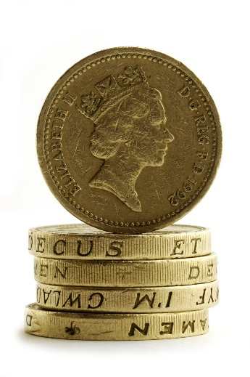
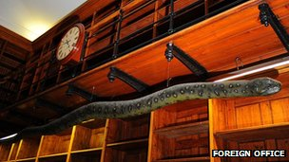
What do they all have in common?
Pound coins
Police phone line 101
Police officers
Albert the snake

Slide 4
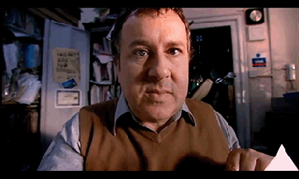
Freedom of information – ­­Tick Tock

