Slide 1
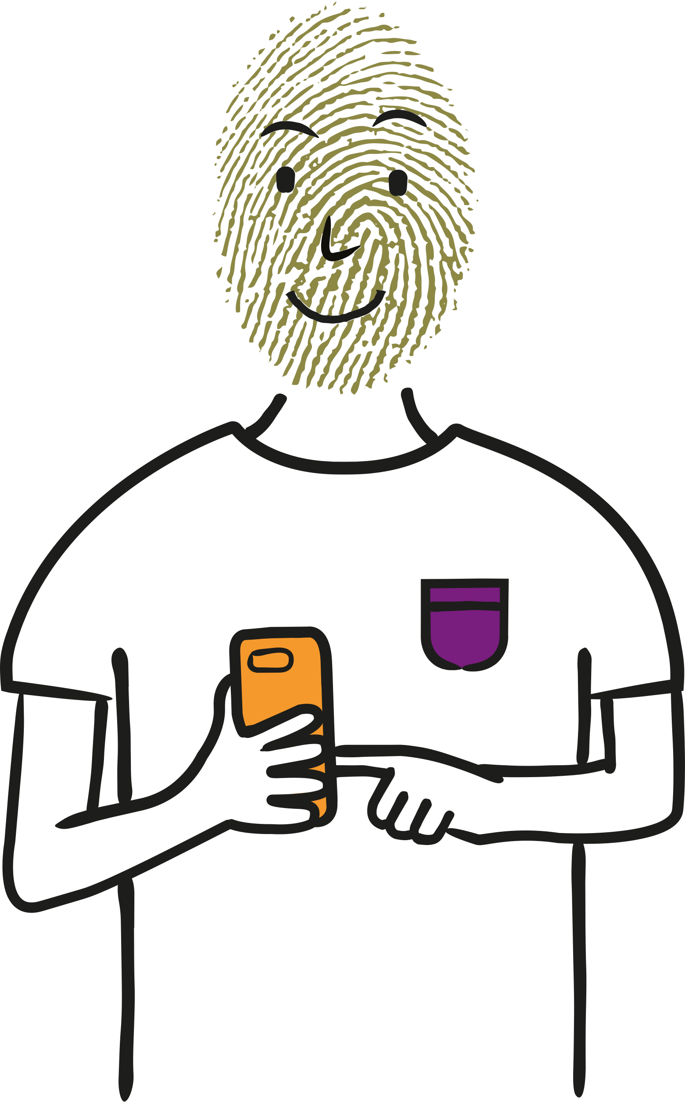
Personal Data - What’s it all about?
Understanding what personal data is and why it is valuable
Age group 11-16

Slide 2
Personal Data - What’s it all about? (Northern Ireland)
This lesson aims to make pupils aware of what personal data is, how it is collected and how it is used.
It can be used as a standalone session or with the follow-up session, Staying Private on Social Media.
Curriculum links
Digital skills KS3 - Digital Citizen
Engage with digital technology safely and meaningfully, including capturing photographs and videos
Avail of digital services and use them safely and in accordance with the law
Consider the moral and ethical impact of digital technology on society
Using ICT
Pupils should demonstrate, when and where appropriate, knowledge and understanding of e-safety including acceptable online behaviour (KS3)
Schools should embed e-safety education into teaching and learning in the Areas of Learning through relevant topics. This will give pupils opportunities to develop their knowledge and understanding of e-safety. (KS4)
Age: 11-16
Timing: 50-60 mins
Learning objectives
Students will learn:
what personal data is
how personal data is collected
why personal data is valuable
Guidance for teaching:
Take time to set clear ground-rules around listening, respect and not using personal or sensitive examples.
Create a positive classroom culture where students feel able to ask questions and also have the right to pass if they don’t feel comfortable answering a question.
Ensure you are familiar with your schools safeguarding policy and procedures, including what do if a student makes a disclosure. Find more information here.
Also ensure that any other whole school policies are followed such as e-safety.
Notes:
(Teacher only)

Slide 3
Personal Data - What’s it all about?
?
Learning objectives
Students will be able to:
?
+
$
describe what personal data is
identify how personal data is collected
explain why personal data is valuable
Notes:
Learning Objectives (1 min)
This lesson aims to aims to make students aware of what personal data is, how it is collected and how it is used.

Slide 4
vv
vv
A A
vv
How many forms of personal data can you think of?
vv
What is
Personal Data?
Personal data is any information that could be used to identify you.
This includes details about yourself, such as your name and age, or your behaviour, such as where you shop and what you buy.
Address
Shopping
Hobbies
Religious beliefs
Race/ ethnicity
Health
vv
Notes:
Starter (5 minutes)
Assess students’ prior knowledge on the topic.
Students should get into pairs and come up with as many examples of personal data as they can. They can create mind maps or use sticky notes to create a class display wall.

Slide 5
What is personal data?
Using at least three of the words in the word bank below, create a definition of personal data.
information
behaviour
yourself
recorded
identify
collected
Notes:
Alternative Starter (5 minutes)
Assess students’ prior knowledge on the topic by asking them to create a definition of personal data and add on anything they already know.
Students should get into pairs and come up with as many examples of personal data as they can. They can create mind maps or use sticky notes to create a class display wall.

Slide 6
What is personal data?
What is personal data?
Using at least three of the words in the word bank below to create a definition of personal data.
In pairs, share your definitions and add on anything you already know about personal data.
Add on any examples of personal data that you can think of.
information
behavior
yourself
recorded
identify
collected
Notes:
Alternative Starter (5 minutes)
Assess students’ prior knowledge on the topic by asking them to create a definition of personal data and add on anything they already know.
Students should get into pairs and come up with as many examples of personal data as they can. They can create mind maps or use sticky notes to create a class display wall.

Slide 7
What is personal data?
Personal data
Personal data is any information that could be used to identify you.
This includes details about yourself, such as your name and age, or your behaviour, such as where you shop and what you buy.
In pairs, share your definitions and add on anything you already know about personal data.
Add on any examples of personal data that you can think of.
Notes:
Alternative Starter (5 minutes)
Show students the definition and compare it to their own. Is there anything they would add or change?

Slide 8
Our personal data can be collected online when we…
Join social media groups
Use a sat nav app
Play online games
Click on adverts
Use a virtual assistant
Use loyalty cards
Share photographs
Send
emails
Complete online
forms
Notes:
Activity 1 (10 minutes)
When we are online, our personal data can be collected in many ways. Ask students how they think our data is collected online.
Then show students the range of places that our personal data is collected from. Ask students if they are surprised by any of these things and if so why.
Can they think of any other sources of personal data?

Slide 9
Our personal data can be collected online when we…
Join social media groups
Use a sat nav app
Personal data
Play online games
Click on adverts
What type of personal data can be collected from these activities?
Complete the worksheet.
Use a virtual assistant
Use loyalty cards
Share photographs
Send
emails
Complete online
forms
Notes:
Activity 1 cont. (10 mins)
What type of personal data can be collected through these activities?
Ask students to complete the Personal Data - How is it collected? worksheet in groups and discuss what type of personal data can be given away through these activities.
Make the point to students that we leave traces behind whenever we do things online. This is called our ‘digital footprint’.

Slide 10
Giving away personal data - Pros
vv
vv
This can make life more convenient. For example:
Companies use our personal data to personalise services for us.
online supermarkets use our addresses to deliver our shopping
streaming platforms remember which episode we were up to, so we can resume easily
online maps can track our locations to send us directions.
vv
Notes:
Activity 2a (10 minutes)
Which other examples of positive uses of personal data can students think of?
They should complete the Personal data – What are the positive uses? worksheet and fill out the Diamond 9 template, sorting the positive uses from most to least beneficial to their own lives.
Share answers with the class.
Start students thinking about why our personal data is being collected online.

Slide 11
Challenge: How do you know your data is being collected?
Taxi apps using your location
Online shopping packages
Recommended events on social media that you may be interested in
Using online maps to navigate
Websites saving passwords and usernames
Looking up the weather
Tracking your phone in case it gets lost
Suggested TV and films to watch on streaming platforms
Notes:
Activity 2b – Discussion (5 mins)
Ask students to share their answers from the Personal data – What are the positive uses? worksheet and show this slide with some suggested answers. It is important to note that giving away personal data is not always a bad thing. It makes our modern lives more convenient. It is also important, however, to be informed and only give away your data when you feel comfortable doing so.
How do you know when your data is being collected?
1) By accepting cookies
When you accept cookies you give permission for your personal data to be collected while you are online. This could include your location, which would help customise a weather app or traffic report. Cookies can remember your username and passwords or what you have placed in your shopping cart. Therefore, they make your online experience easier.
However, you should be selective when accepting cookies – sometimes you may not want your login information remembered for security reasons, or you may not want your online activity tracked while on a particular web page e.g. you don’t want to be targeted for special offers.
2) By accepting Terms and Conditions
Check the privacy policy / terms and conditions. These outline what data can be collected and shared when you are on a web page or app.

Slide 12
Giving away personal data - Cons
Personal data
Discuss:
What might be the cons of giving away personal data?
Notes:
Discussion (5 minutes)
Start a class discussion about what might be the cons of giving away personal data and record students’ prior knowledge about this on the whiteboard.

Slide 13
Giving away personal data - Cons
z
z
z
Sometimes our personal data can be used in ways we don’t expect or don’t even know about.
Personal data
Companies want to know the things people like and dislike, how they spend their time, and what they buy.
‘Data brokers’ track and analyse large sets of information including personal data, which they can sell to businesses, such as retailers.
Discuss:
What might be the cons of giving away personal data?
Notes:
Discussion (5 minutes)
Show students the three bullet points above and read through as a class.

Slide 14
Giving away personal data - Cons
Giving away personal data - Cons
z
z
z
Sometimes our personal data can be used in ways we don’t expect or don’t even know about.
Personal data
Companies want to know the things people like and dislike, how they spend their time, and what they buy.
‘Data brokers’ track and analyse large sets of anonymised personal data, which they can sell to businesses, such as retailers.
Why is this personal data so valuable to businesses?
Can you think of any more risks of sharing personal data?
Discuss:
What might be the cons of giving away personal data?
How comfortable are you with your data being shared and why?
Notes:
Discussion cont. (5 minutes)
Why is personal data so valuable to businesses? (It has been said that data is now more valuable than oil.) (Data helps businesses understand how different groups of people live, what appeals to them, and what their spending habits are. This allows businesses, such as retailers, to tailor their marketing, messaging and products towards the groups they want to target. Groups might be people of a specific gender, age, location, or category, such as parent, teenager, office worker, football fan etc.)
How comfortable are students with the idea of people’s data being shared? What are the risks? Is sharing anonymised shopping data different to sharing identifiable personal data, such as their email addresses?
Can you think of any more risks of sharing personal data? (identity theft, fraud, online reputation, once something is online it can’t be removed easily)

Slide 15
Giving away personal data - Cons
Challenge
Why is this personal data so valuable to businesses?
Can you think of any more risks of sharing personal data?
Challenge:
What is GDPR and how does it link to the sharing of personal data? Is it a good thing there are more rules in this area? Why or why not?
How comfortable are you with your data being shared and why?
Notes:
Optional extension
Introduce the concept of General Data Protection Regulation (or GDPR). Before the recent changes to the law, companies were more free to use and share your personal data, such as contacting you with marketing emails. Now, there are rules in place to make sure that your data is held safely, not to for too long, and you can only be contacted if you agree to it. Do students think this is a good thing or not? Why?

Slide 16
Erin likes a climate change campaign page on social media
Erin checks into a climate change demonstration
Erin clicks on a link which takes her to an online blog about climate change
Erin’s personal data is collected to build a profile of her interests
Notes:
Activity 3 (5 minutes)
Erin is on a social media app. Her location and online activity is collected by the app to build a profile about her. This profile helps the app to show her targeted posts and adverts that are personalised, based upon her location and interests. If she has given data like her age and gender to the platform, this will also be used to target her with relevant posts.

Slide 17
Erin likes a climate change campaign page on social media
Erin checks into a climate change demonstration
Erin clicks on a link which takes her to an online blog about climate change
Erin’s Personal Data
Erin’s personal data is collected to build a profile of her interests
Websites and apps use our data to build a profile of our interests. This profile is used to show us targeted adverts that appeal to our preferences.
What kinds of adverts do you think Erin will see based upon her online activity?
Notes:
Activity 3 (5 minutes)
What sort of posts do you expect that Erin will see as a result of her activity? Collect students’ answers on the board.

Slide 18
Erin likes a climate change campaign page on social media
Erin checks into a climate change demonstration
Erin clicks on a link which takes her to an online blog about climate change
Erin’s personal data is collected to build a profile of her interests
On her social media feed Erin sees videos advertising her local political party’s work on climate change
When she goes online Erin keeps seeing adverts for Eco-Warrior, a new sustainable clothing brand
Notes:
Activity 3 (5 minutes)
Discuss how Erin’s profile has been used by the social media platform to show her advertising for a sustainable clothing brand. Why do students think this brand’s advert has appeared?
Erin’s profile, including age, location and interests, has been used to show her a sponsored post about her local political party’s climate change activism. Why has she seen this?
Do students think that political parties should be able to use our data to target us with content? What are the potential positives and negatives?
In pairs, students should take turns to give each other three examples of online activities and come up with likely targeted adverts or content.

Slide 19
Discuss:
Challenge question:
What are the similarities between data rights and human rights?
vv
Do you think websites and apps should be allowed to collect our data or would you prefer to keep it private?
Do you think it is right that organisations, such as political groups, can use our data to influence our opinions?
vv
A A
vv
vv
What are the potential risks of collecting personal data?
What are the potential negative outcomes of targeted advertising? What are the benefits?
vv
Notes:
Plenary discussion or Draw and write activity ( 5 minutes)
To wrap up the lesson, hold a quick-fire class discussion around these debating points, OR ask students to write down their answers.
To answer questions 3 and 4 students can choose to draw the potential outcomes / risks and label their images.
Challenge question: What are the similarities between data rights and human rights? Things to discuss could include the right to privacy, the right to safety, freedom of expression.

Slide 20
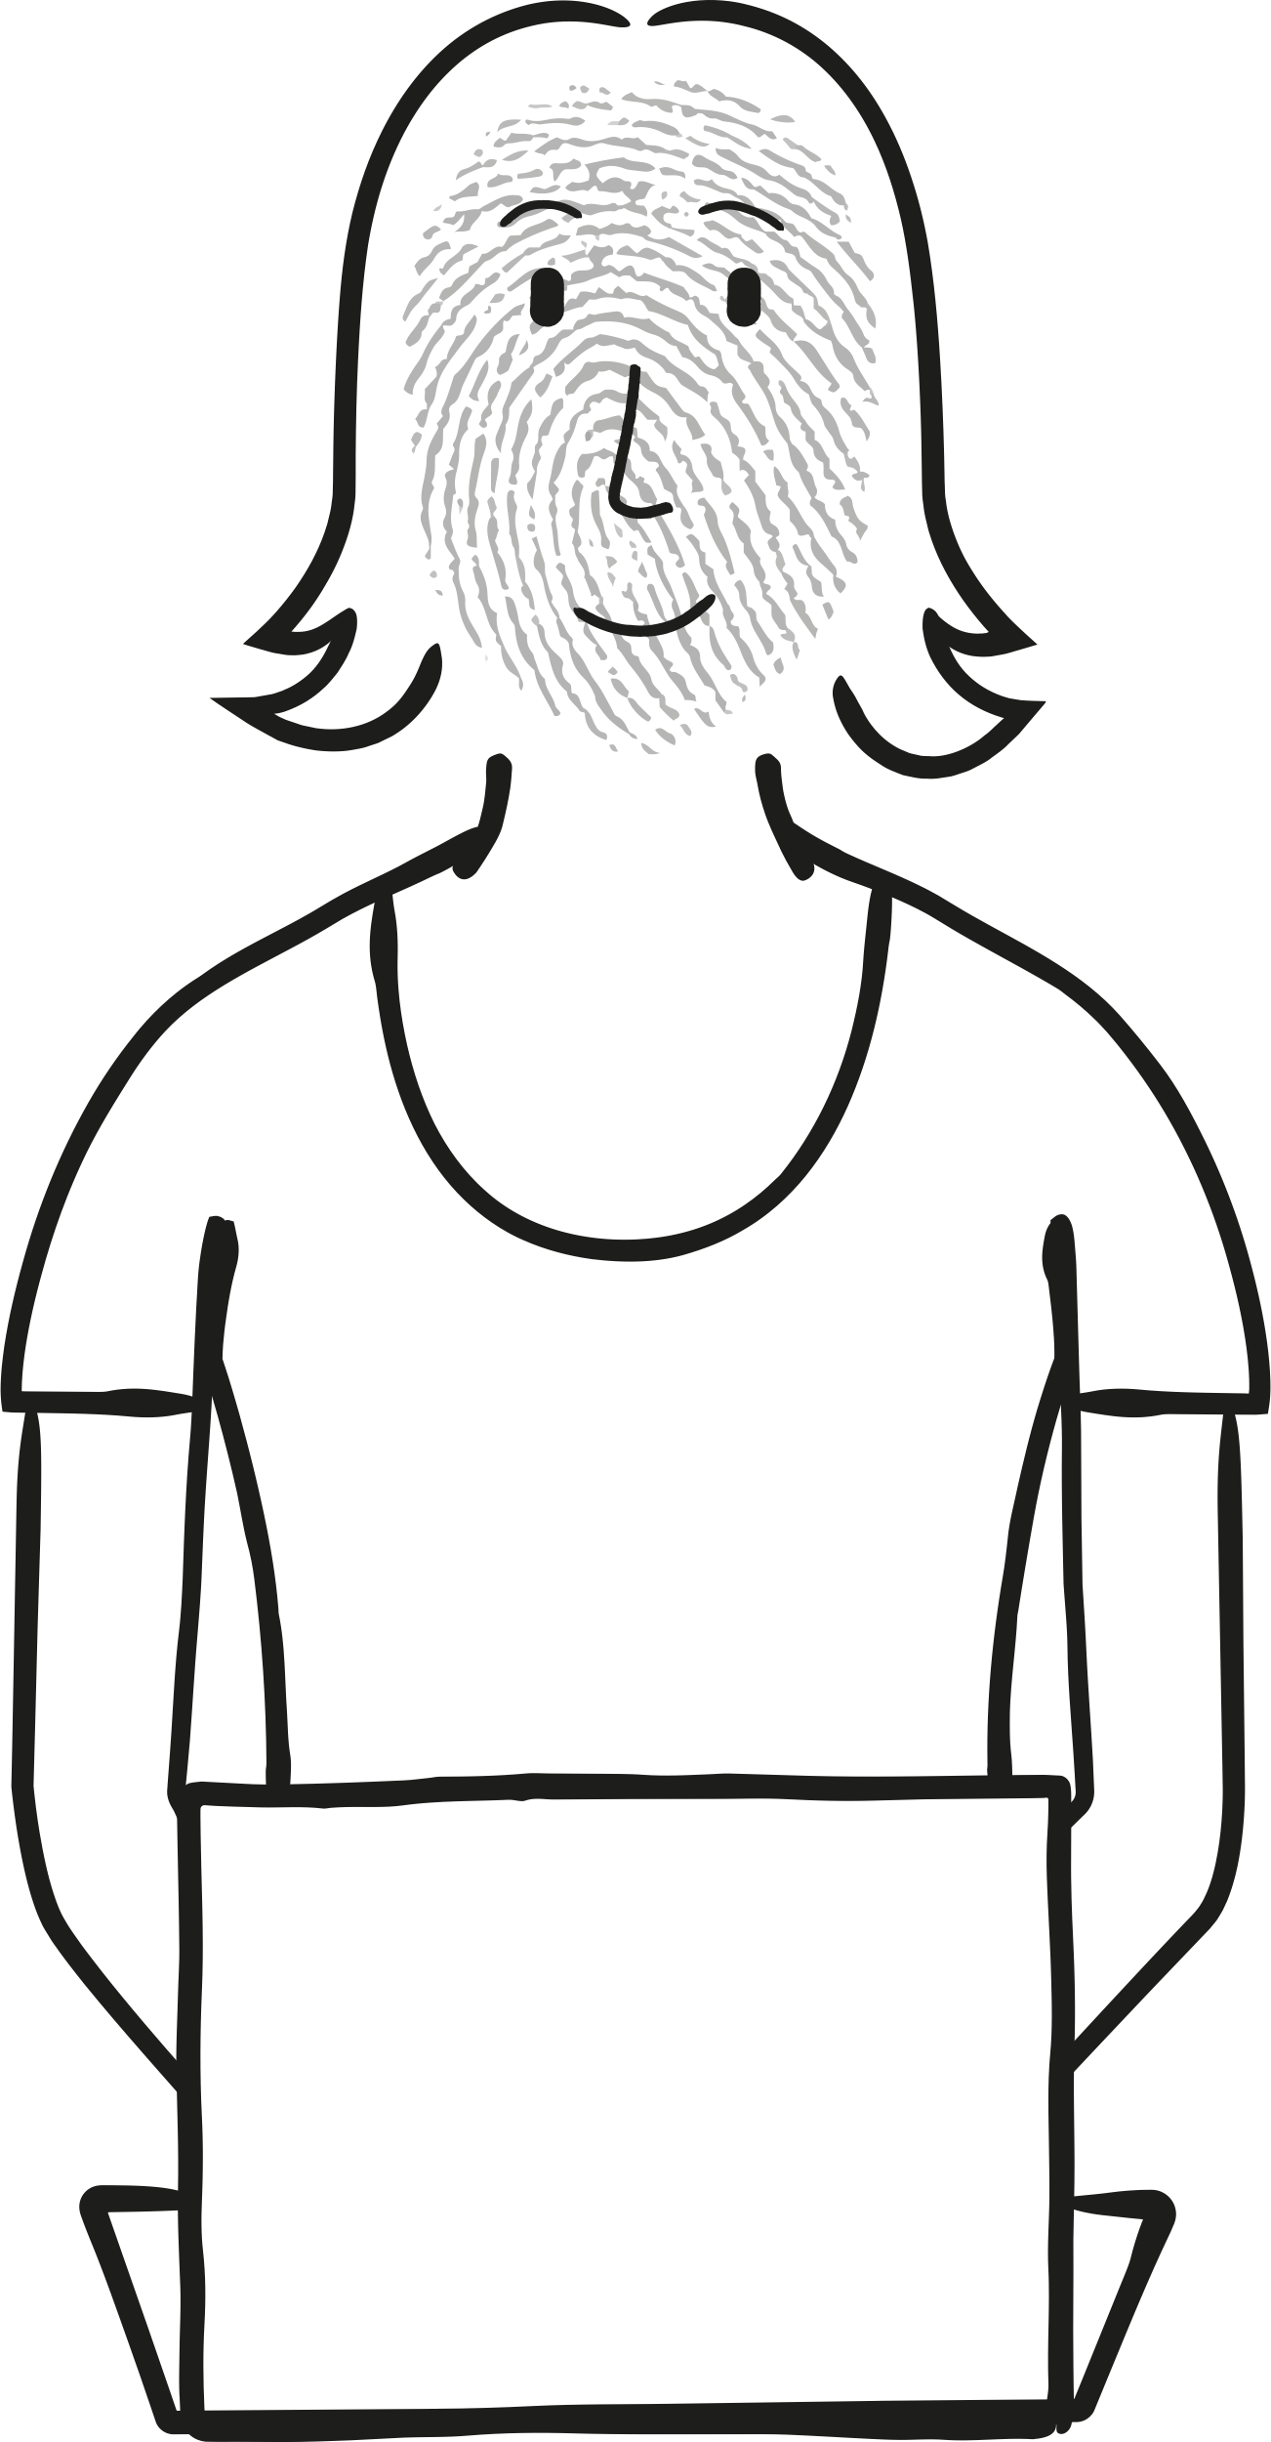
Echo chamber
Erin’s friend has posted an article on social media about how Covid-19 is spreading in a new way that people haven’t yet realised.
Erin clicks on and reads the article. It worries her because she doesn’t want to catch or spread Covid. She searches online and finds more articles about Covid but they all say different things about how you can catch or spread it.
Over the next week her social media feed is full of blogs and posts about Covid, which is starting to really stress her out.
Erin texts her aunt who is a GP. Her aunt explains that you need to think critically about what you read online and invites her to have a chat to discuss it further.
Notes:
Plenary extension - if time allows
One of the dangers of targeted content based on personal data is that it creates an online ‘echo chamber’.
An echo chamber is when we tend to see only articles or posts similar to what we already believe or think.

Slide 21
Echo chamber
Erin’s friend has posted an article on social media about how Covid-19 is spreading in a new way that people haven’t yet realised about.
Erin clicks on and reads the article. It worries her because she doesn’t want to catch or spread Covid. She searches online and finds more articles about Covid but they all say different things about how you can catch or spread it.
Over the next week her social media feed is full of blogs and posts about Covid, which is starting to really stress her out.
Erin texts her aunt who is a GP. Her aunt explains that you need to think critically about what you read online and invites her to have a chat to discuss it further.
Echo chamber
This is an example of an echo chamber.
How does it come about?
What are the possible risks of online echo chambers?
Notes:
Plenary extension - if time allows
Ask students to discuss how the echo chamber came about in Erin’s case. Can they give examples of some of the risks of this? (They can mean that people's opinions aren’t challenged, and that rumours, myths and fake news can spread quickly around the internet. Some people believe online echo chambers are leading to a more divided society.)

Slide 22
!
The ICO is here for you...
Check T&Cs (terms and conditions) before you opt in to giving away contact details, or signing up to websites and apps.
You have the right to know that your data is being collected. You can ask to see the data that companies have collected on you, and you can ask them to delete it.
!
Check settings - there are things you can control, such as allowing notifications, location trackers and marketing emails.
Think before giving data away, such as your name, age, gender, email address. Consider where your data may end up and whether it will be kept secure.
Go to https://ico.org.uk for help or to report anything that doesn’t feel right.
Notes:
Explain to students that there are laws that exist around what companies can and cannot do with your data. In the last few years, more laws have been brought in around personal data, such as GDPR. If companies break the law they can be fined up to £17 million.
The Information Commissioner has written a new Code of Practice with standards on what providers of online services used by children should and shouldn't do with their personal data. This should mean that some things about the websites and apps they use should change in the future. For example, they should get better explanations about how their personal data is used, and they shouldn't be profiled automatically without them knowing it’s happening.

