Slide 1
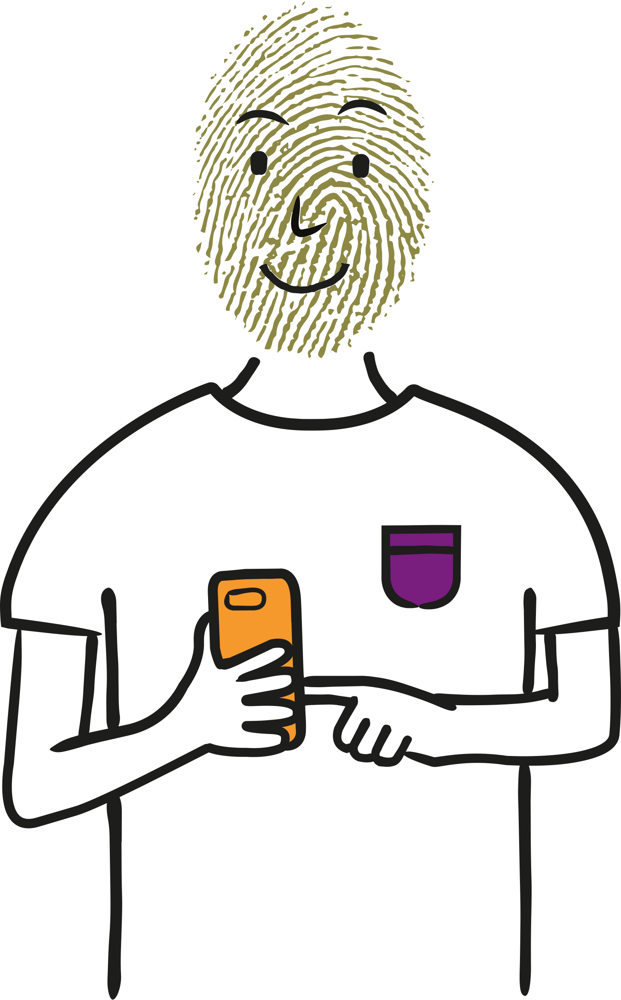




Staying Private on Social Media
Understanding how your data is used on social media
Age group 11-16

Slide 2
Staying Private on Social Media (Wales)
This lesson aims to make students aware of what personal data is, how it is collected and how it is used. It can be used as a standalone session or with the previous session, Personal Data - What’s it all about?.
Age: 11-16
Timing: 50-60 mins
Learning objectives:
How personal data can be collected and used on social media platforms.
Ways to keep your data private from other users on social media.
What a digital footprint is and why it matters.
Guidance for teaching:
Take time to set clear ground-rules around listening, respect and not using personal or sensitive examples.
Create a positive classroom culture where learners feel able to ask questions and also have the right to pass if they don’t feel comfortable answering a question.
Ensure you are familiar with your school’s safeguarding policy and procedures as well as the Wales Safeguarding Procedures, including what to do if a learner makes a disclosure. For more information, see the statutory safeguarding guidance: Keeping learners safe
Also ensure that any other whole school policies are followed, such as online safety.
Personal and social education³
Key Stage 3 - Developing ICT
Learners should be given opportunities to use ICT safely with appropriate support and guidance.
Key Stage 4 - Developing ICT
Learners should be given opportunities to use ICT safely, responsibly and independently, complying with data protection regulations and following safe practices.
Digital Competence Framework – Citizenship - Identity, image and reputation⁴
Year 7 Explain how their digital usage is tracked, e.g. know basic data protection laws and how organisations are responsible for the security of collected data
Year 8 Discuss the benefits and risks of presenting themselves in different ways online, e.g. professionally and personally.
Year 9 Understand that they have a digital footprint and that this information can be searched, copied and passed on, e.g. know how to check the security configurations of their devices and/or the software they use.
Year 10 Understand the ways websites and companies collect data online and utilise it to personalise content for their users, e.g. personal data being shared.
Recognise the risks and the uses of data/services on personal devices within the terms and conditions of a range of software and web services.
Year 11 Identify and describe the data protection policies of a variety of organisations located in different countries, and how this affects the way that they work.
Identify how organisations become data compliant when using multi-national products.
Curriculum for Wales - The Health and Well-being Area of Learning and Experience
In the new Curriculum for Wales, the Health and Well-being Area of Learning and Experience is about developing the capacity of learners to navigate life's opportunities and challenges. Relationships and Sexuality Education (RSE) will be a mandatory requirement in the new curriculum.
Further guidance to practitioners underlines the importance of developing safe behaviour in relation to digital media and the online world. Learners should be encouraged to develop their understanding of the increasing influence of technology on their daily lives and the implications this may have for their health and well-being, in particular the possible impact on physical, mental and emotional health and well-being. Decision-making, risk assessment and safe and unsafe situations and interactions should all be considered in digital contexts. This includes relationships with others, online safety, legal implications and social influences online (including social media).
³The PSE framework will be superseded by the Curriculum for Wales.
⁴A revised version of the Digital Competence Framework is available to support the Curriculum for Wales and opportunities to develop digital competence across all areas of learning and experience.
Notes:
(Teacher only)

Slide 3


Staying Private on Social Media
      ?
      Learning objectives
      Students will learn:
?
!
Ways to keep your data private from other users on social media.
What a digital footprint is and why it matters.
How personal data can be collected and used on social media platforms.
Notes:
Learning Objectives (1 min)
This lesson aims to aims to make students aware of how person data is collected and used on social media, how to keep data private, and what a digital footprint is and why it matters.

Slide 4
Social Media Quiz
Question:
There are 66 million people in the UK. How many do you think are using social media?
Answer:
45 million
Notes:
Starter (5 minutes)
Ice breaker exercise to start students thinking about the topic of social media and data privacy.
Put students’ answers on the board, and see who got the closest when the answer is revealed.

Slide 5
Social Media Quiz
Social Media Quiz
Question:
There are 66 million people in the UK. How many do you think are using social media?
Answer:
45 million
Question:
What percentage of these people do you think check or adjust their privacy settings on social media?
a) 25% b) 50% c) 75%
Answer:
Just 25%
Notes:
Starter cont. (5 mins)
Ask students to vote as a class on the right answer. Discuss why they think this might be.

Slide 6
Social Media Quiz
Social Media Quiz
Social Media Quiz
Question:
There are 66 million people in the UK. How many do you think are using social media?
Answer:
45 million
Question:
What percentage of these people do you think check or adjust their privacy settings on social media?
a) 25% b) 50% c) 75%
Question:
In your opinion, how important is data privacy to the average UK teenager?
Answer:
Just 25%
0
10
Notes:
Starter cont. (5 mins)
Recap the definition of personal data from the lesson on Personal Data - What’s it all about? Or, if the class hasn’t been taught that lesson, introduce personal data as any information that can identify us or our behaviours.
Ask students for their opinions on how important they think data privacy is to young people. How much do young people think about the details they are giving away - either to the platform itself, or to other users?

Slide 7
Social Media Quiz
Social Media Quiz
Social Media Quiz
Did you know:
Question:
There are 66 million people in the UK. How many do you think are using social media?
Answer:
45 million
Question:
What percentage of these people do you think check or adjust their privacy settings on social media?
a) 25% b) 50% c) 75%
Answer:
Just 25%
To steal your identity someone needs your birthday, age and address.
These details can be found on many children’s social media profiles.
Question:
In your opinion, how important is data privacy to the average UK teenager?
0
10
Notes:
Starter cont. (5 mins)
Show students the information. Are they surprised at how much information is needed to steal someone’s identity?

Slide 8


vv
vv
Hey Bilal do you have Pix?
Hi Ella. Nah, what’s that?
Photo and video sharing app. Cool filters…
I’ll download tonight when I’ve got WiFi
Message you later on it.
vv
A A
vv
vv
Notes:
Activity 1 – Discussion and decisions (20 minutes)
Give out the Social media decisions worksheet to each student.
As a class, read through the different decisions on the next six slides.
At each question stage, ask the class to discuss the pros/cons/thoughts and add these notes to each question. Then take feedback as a class and share the information in the teachers notes.
Once the class has discussed, ask students to decide what they think Bilal should do and why. They can put a tick or cross in the box following the decision and explain their thinking.

Slide 9

vv
      ?
Should Bilal set up a new account or link it to an existing social media account?
Create a new account
Name
Age
Email address
Phone number
or
Login with existing
social media account
vv
Notes:
Activity 1 – Discussion and decisions cont.
Q. Should Bilal create a new account or link it to an existing social media account?
Linking to social media account is more time efficient. Bilal won’t have to set up an account from scratch but the app will learn a lot about him very quickly through data sharing from his already existing profile. Bilal might get targeted adverts more quickly and ultimately more data will be shared.
Creating a new account will still require Bilal to share his personal data but this will be done more directly. The app won’t know what is in his other social media accounts.

Slide 10
vv
      ?
Should Bilal set up a new account or link it to an existing social media account?
      ?
Create a new account
Some social media platforms set an age restriction on their platform. For example, they may say that users must be 13 years old to register.
Name
Age
Do you think there should be an age limit? Why/why not?
Is 13 the right age? Why/why not?
Do you think it should be older or younger? Why/why not?
Email address
Phone number
or
Login with existing
social media account
vv
Notes:
Activity 1 – Discussion and decisions cont.
Either as a class discussion or as break-out pairs, ask students to discuss their thoughts around age restrictions for social media. Do they think it is a good idea?
Ask students to share their answers, and note if any of them raise the issue of data protection in the context of age restrictions. Do they think that young people should be old enough to understand how their personal data is used and collected before using social media?

Slide 11
vv
      ?
Should Bilal allow notifications or not?
Allow push notifications so
that you don’t
miss anything!
Block
Allow
vv
Notes:
Activity 1 – Discussion and decisions cont.
Q. Should Bilal allow or block push notifications?
As a class or in pairs, discuss the question and add their thoughts to the decision tree.
This is a personal preference, but Bilal should be aware that if he allows push notifications, the app can send him notifications even when he is not using it. Although notifications are useful for telling the users when they have new activity, they can be intrusive and even addictive.
Ask students to discuss potential downsides of notifications. For example, they can be disruptive if you are trying to focus on school work.
What are the upsides? Fitness apps can help encourage you to go for walks and live more healthily, notifications make sure that you don’t miss important information.
How can apps use notifications to try and make money? Notifications can encourage in-app purchases, such as on gaming apps, or they can push people to upgrade to the premium version of the app or service. Do students think that notifications should be used in this way? What if the users are children?
The new ICO code will mean that for child users, in the future, location services and notifications should be turned off by default (though they could still turn them on if they want to).

Slide 12
vv
      ?
      ?
Should Bilal allow notifications or not?
Enable location services
Which option should Bilal click on?
Never
While using the app
Always
vv
Notes:
Activity 1 – Discussion and decisions cont.
Q. Which option should Bilal choose for his location settings?
Ask students for some of the pros and cons of enabling location services.
By enabling location services, Bilal can post and link any photos or videos to specific locations. This can make searching for photos or videos easier and also means he can use geotagging to share with friends where he has been. (geotagging: adding a location tag to a photo or video)
However, if Bilal enables location services, the app will also be able to collect and store data about HIS location, especially if he chooses ‘always’.
Do students think Bilal should try and keep his location data private, or do they think he would be happy to share it with the app? Always, or just while using the app?

Slide 13
vv
      ?
      ?
      ?
Should Bilal allow notifications or not?
You must agree to the terms and conditions before you can use Pix
Which option should Bilal click on?
What might Bilal be agreeing to in the Terms and Conditions?
I accept the terms and conditions
vv
Notes:
Activity 1 – Discussion and decisions cont.
Q. What might Bilal be agreeing to in the Terms and Conditions?
The Terms and Conditions (Ts&Cs) explain how the social media platform can use both your content (the posts you make, photos you upload, messages you send) and your personal data. Consent for data sharing may be hidden in terms and conditions. Data sharing means that personal data can be passed on or sold to different organisations.
When signing up to things it is good to check the privacy policy to confirm who will be seeing personal data, and who it is being shared with. This can help people decide whether or not it is worth it to give their personal data away.
What could happen if Bilal hands over his personal data? The data could be used to build an online profile of Bilal, to target him with ads relating to his age group, gender, location etc.
Briefly recap that data is captured to build profiles of users in order to target them with advertising and other messaging.
The ICO's new code should make things easier in the future because it means that children's personal data isn't used for profiling 'by default' and they should get better, more accessible explanations of how their data is used ( eg videos or animations rather than lots of text).

Slide 14
vv
Private or Public account?
      ?
As well as thinking about how much personal data to share with social media platforms, it is also important to consider other users.
Which type of profile do you want?
      ?
Private
(only your friends and contact list can see what you post)
Should Bilal choose a private or public profile?
Public
Anyone can see what you post
vv
Notes:
Activity 1 – Discussion and decisions cont.
Q. Which type of profile should Bilal get and why?
Tell students that Bilal is 15. Take a class vote. Do their opinions change if Bilal is 13, or 25?
When making a decision, Bilal should be aware that if he has a public profile anyone can see and record his activity. It is also easy for people to commit identity theft based upon personal details given out over social media. A public profile may lead to unwanted people following him, and embarrassing photos or videos could affect employment in the future.
If necessary, remind students that even on a ‘private’ account, data will be shared with the app and could be passed or sold on.

Slide 15
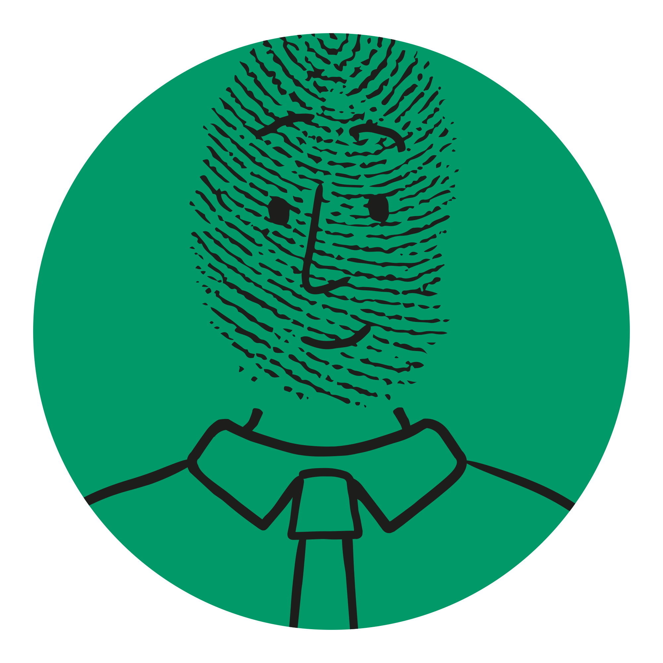
      ?
If Bilal has agreed to all the requests, linked his profile to an existing social media account and set it to public, what kind of information might be available online about him?
Notes:
Activity 1 – Discussion and decisions cont.
Encourage students to look at each decision to think about what type of information might be available about him and and answer the question above.

Slide 16
      ?
Challenge
If Bilal has agreed to all the requests, linked his profile to an existing social media account and set it to public, what kind of information might be available online about him?
Challenge:
To what extent do you think most young people are aware of the amount of data stored on them?
Do you think more should be done?
Notes:
Activity 1 – Discussion and decisions cont.
Ask students to think about the question on the slide. Do they think most young people are aware of how much of their personal data is collected and used? Should more be done to limit this?

Slide 17

Pix has been hacked
Credit card
details
Photos
User name
Email address
Birthday
Contacts
Password
Family details
Location
Address
Notes:
Activity 2 – Protecting your personal data (10 minutes)
Give students a copy of the Protecting your personal data worksheet and introduce Jaiden, another Pix user.
Even if you have a private profile, there is always the chance that the platform you are signed up to will get hacked. User details, such as email addresses, bank details, passwords can get stolen and sold.
What details could be stolen from an app if it is hacked? Ask students to read through what Jaiden has been posting on Pix and decide what details could be stolen from their profile. Discuss students’ thoughts and then display the details on the slide.

Slide 18
Pix has been hacked
Credit card
details
Photos
User name
Discuss
Email address
Birthday
Contacts
Discuss:
How might Jaiden’s hacked data be used?
Password
Family details
Location
Address
Notes:
Activity 2 – Protecting your personal data cont.
Discuss the question on the slide. Once a hacker has access to Jaiden’s data, how could that data be used?

Slide 19
What could hackers do with this information?
      ?
How much do you think a stolen identity (personal data) is illegally sold for on the ‘dark web’?
Your personal data could be sold on illegal sites online (sometimes called the ‘dark web’) and used to make payments, transfer money, buy medication, and apply for loans or credit cards.
If your email and password are stolen, a hacker could now have access to your other social media platforms and online accounts.
      !
As little as £10 for a basic ID and as much as £820 for a person’s full online identity.
Notes:
Activity 2 – Protecting your personal data cont.
Take the students’ feedback from the question on the previous slide and then read through the points on this slide.
Ask students to guess how much a stolen identity is sold for on the ‘dark web’. Show them the answer.
Ask students to discuss what they think Jaiden should do and record their answers. (Answers should include: Change their password, block any suspicious followers, change the passwords of any linked accounts, check bank account for possible fraud and report to online platforms.)

Slide 20
What could hackers do with this information?
      ?
How much do you think a stolen identity (personal data) is illegily sold for on the ‘dark web’?
Your personal data could be sold on an underground market (sometimes called the ‘dark web’ ) and used to make payments, transfer money, buy medication, and apply for loans or credit cards.
If your email and password are stolen, a hacker could now have access to your other social media platforms and online accounts.
Personal data
What should Jaiden do if they believe their personal data might have been hacked?
      !
As little as £10 for a basic ID and as much as £820 for a person’s full online identity.
Notes:
Activity 2 – Protecting your personal data cont.
Take the students’ feedback from the question on the previous slide and then read through the points on this slide.
Ask students to guess how much a stolen identity is sold for on the dark web. Show them the answer.
Ask students to discuss what they think Jaiden should do and record their answers. (Answers should include: Change their password, block any suspicious followers, change the passwords of any linked accounts, check bank account for possible fraud and report to online platforms)

Slide 21
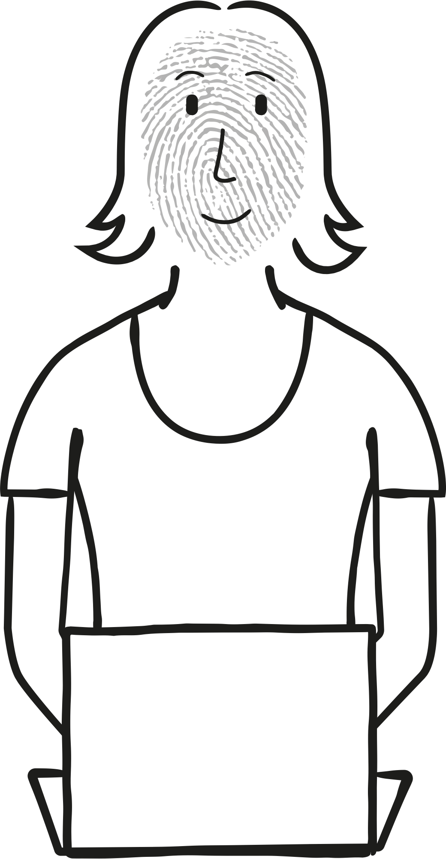
How to keep your data safe!
Rejecting any unknown requests
or spam messages
Only downloading and accepting terms and conditions/cookies of trusted sites
Using a private profile not a public one
Limiting the personal data you give away on apps and social media accounts
Not using the same passwords for multiple accounts (and changing them regularly)
Notes:
Activity 2 – Protecting your personal data cont.
Ask students to choose three methods that Jaiden could have used to protect themselves. For each of these ideas, they should decide on the pros and cons, then give each idea a score from 1 to 10 for how effective they think it would be. Ask them to explain their answers.
Show them the ideas on the board if they are stuck.

Slide 22

Cara is a recent graduate. She’s been offered a job and posts this poll as a joke to her public social media account.
Got the job offer from N&C Digital!!
So much money – yay – but so boring.
Should I walk away or sell out…
¯\_(ツ)_/¯
Take the
money!
Run!
Notes:
Activity 3 – Digital Footprint (10 minutes)
Discuss the potential consequences of Cara’s actions. As an option, bring up news articles of similar situations to show the real-world examples of this outcome.

Slide 23
Cara is a recent graduate. She’s been offered a job and posts this poll as a joke to her public social media account.
Got the job offer from N&C Digital!!
So much money – yay – but so boring.
Should I walk away or sell out…
¯\_(ツ)_/¯
Social media poll
What do you think could happen next?
Take the
money!
Run!
Notes:
Activity 3 – Digital Footprint (10 minutes)
Discuss the potential consequences of Cara’s actions. As an option, bring up news articles of similar situations to show the real-world examples of this outcome.

Slide 24

Digital Footprints - What do you think this means?
Things you put online can stay there forever.
      ?
If a future boss looked at your posts or your comments on other people’s posts – what impression would they get of you?
      ?
If you checked through your social media what your digital footprint look like?
Notes:
Activity 3 – Digital footprint cont.
Discuss the concept of a ‘digital footprint’; that our activity online builds a picture or an impression of who we are. Give students the Digital footprints worksheet and ask them make a list of things that could be in their digital footprints.
Then ask students to complete the following page ‘Why do digital footprints matter?’ Encourage them to think about everything they have learnt in the lesson about personal data in their answer and use PEE (Point, Explanation, Example) to extend their writing.

Slide 25

vv
What advice would you give to a 13 year old who is just starting to use social media?
Notes:
Plenary (5 minutes)
Ask students to consider what three pieces of advice they would give to a 13 year old who is starting to use social media. This can be used as a final assessment and consolidation of learning.

Slide 26
If you need help…
      !
      !
The Information Commissioner’s Office (ICO) is here for you.
If you have any questions about your personal data or want to report something that doesn’t feel right go to ico.org.uk

